Slide 1

Drainage of Agricultural lands
Environmental impact of drainage
Methods; overview
Drainage requirement – soil types, climate, land use
Agricultural drainage planning, design and management
NIYONKURU Rose
Department of Irrigation and Drainage
UR-CAVM

Slide 2
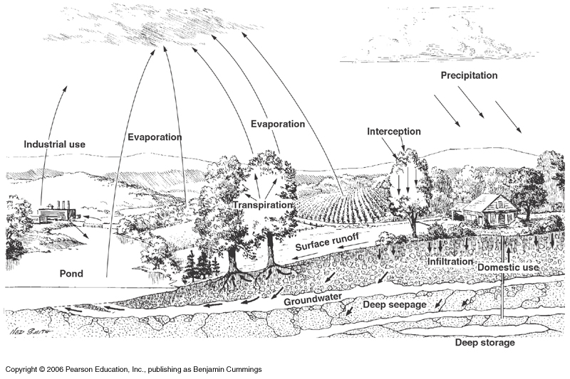
Water or hydrologic cycle
Notes:
Local scale, major pathways of water movement
Solar radiation drives the water cycle.

Slide 3
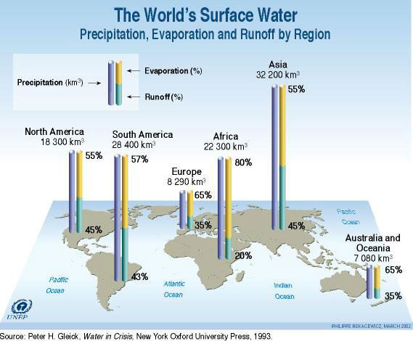

Slide 4
Land drainage
“Land drainage is removal of excess surface and
subsurface water from land to enhance crop growth,
including the removal of soluble salts from the soil”
International Commission on Irrigation and Drainage (ICID, 1979)

Slide 5
Land drainage – Principles and methods
Why drainage?
Environmental impact of drainage
Methods; overview
  Surface drainage
  Subsurface drainage
  Controlled drainage
  Tube well Drainage systems
  Mole drainage
  Slit drainage

Slide 6

Drainage Problem…?
About 25 million hectares of prime agricultural land became unproductive due to irrigation-induced water logging and salinity
30 – 50 per cent of the worlds’ irrigated lands developed some form of drainage problem
About 250 million hectares in rain fed cropland need improved drainage
Considerable increase in crop production could be achieved through drainage without additional land and water resources exploitation.
Notes:
On a global scale, 170 million ha of cropland require drainage and/or flood protection. Drained lands are a very important part of our resource base on both global and national scales.

Slide 7
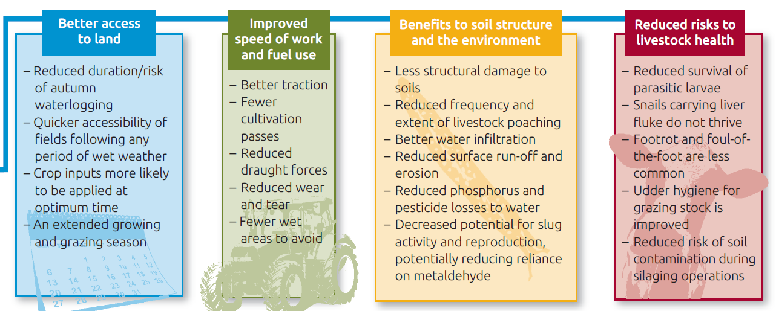
Why drainage?

Slide 8
Why land drainage?
Improved
speed of work
and fuel use
Better access
to land
Benefits to soil structure
and the environment
Reduced risks to
livestock health

Slide 9
Why land drainage?
Better access to land;
Reduced duration/risk of waterlogging
Quicker accessibility of fields following any period of wet weather
Crop inputs more likely to be applied at optimum time
An extended growing and grazing season

Slide 10
Why land drainage?
Improved speed of work and fuel use;
Better traction
Fewer cultivation passes
Reduced draught forces
Reduced wear and tear
Fewer wet areas to avoid

Slide 11
Why land drainage?
Benefits to soil structure and the environment;
Less structural damage to soils
Reduced frequency and extent of livestock poaching
Better water infiltration
Reduced surface run-off and erosion

Slide 12
Why land drainage?
Benefits to soil structure and the environment;
Reduced phosphorus and pesticide losses to water
Decreased potential for slug activity and reproduction, potentially reducing reliance on metaldehyde

Slide 13
Why land drainage?
Reduced risks to livestock health;
Reduced survival of parasitic larvae
Snails carrying liver fluke do not thrive
Footrot and foul-of the-foot are less common
Udder hygiene for grazing stock is improved
Reduced risk of soil contamination during silaging operations

Slide 14
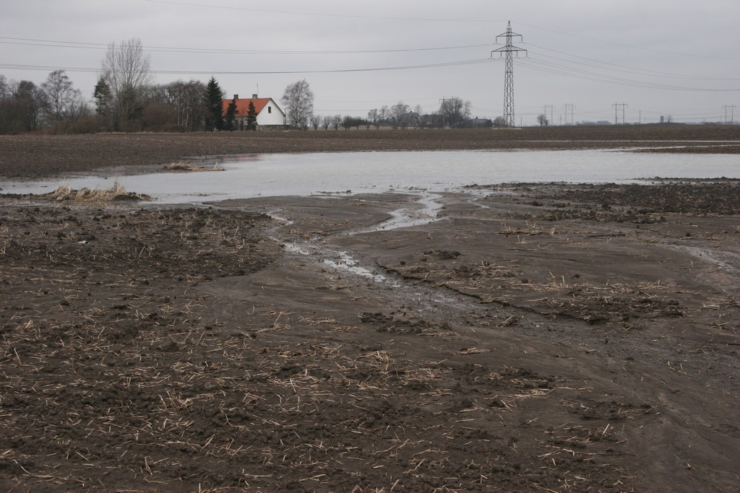
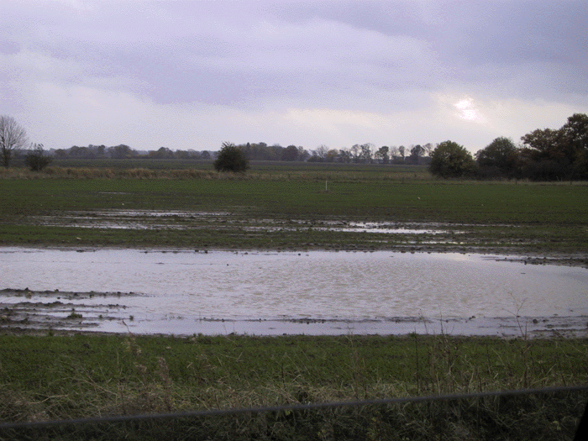
Drainage to control ponding
Ponding is the accumulation of excess water on the soil surface

Slide 15
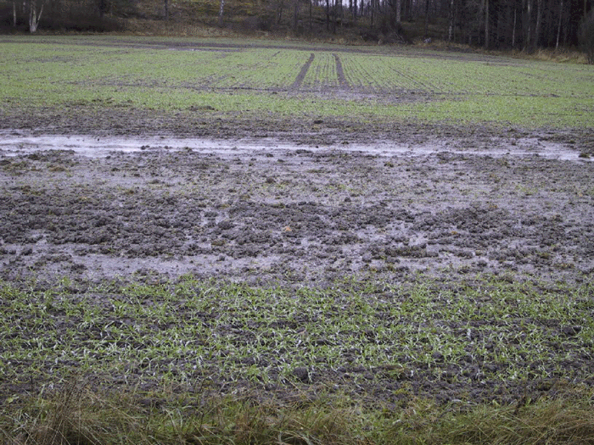
Drainage to control water logging
Water logging is the accumulation of excess water in the root zone of the soil.

Slide 16
Drainage to control water logging
Prolonged waterlogging under the surface may not be so obvious. Poor drainage conditions may be identified by:
Poor crop health or yields: overlaying a yield map onto a field drainage map can identify problem areas
High surface run-off rates and soil erosion
Limited field access without rutting or poaching (animal hoof damage) compared with other fields in the area

Slide 17
Drainage to control water logging
Poor drainage conditions may be identified by:
The presence of wet-loving plant species, such as common rush and redshank
Susceptibility to drought due to poor root development and limited rainfall percolation into the soil

Slide 18
Drainage to control water logging
If drainage problems are widespread across the field, it may be that:
Soil management is not adequate
No drains have been installed
Mole drains need to be renewed
In flatter fields, the outfall may simply be blocked
The drainage system requires maintenance or has reached the end of its useful life

Slide 19
Environmental concern
Surface run-off may occur which can result in transport of ;
faecal material
sediment,
soil-borne diseases (eg clubroot)
nutrients or agrochemicals
to watercourses.

Slide 20
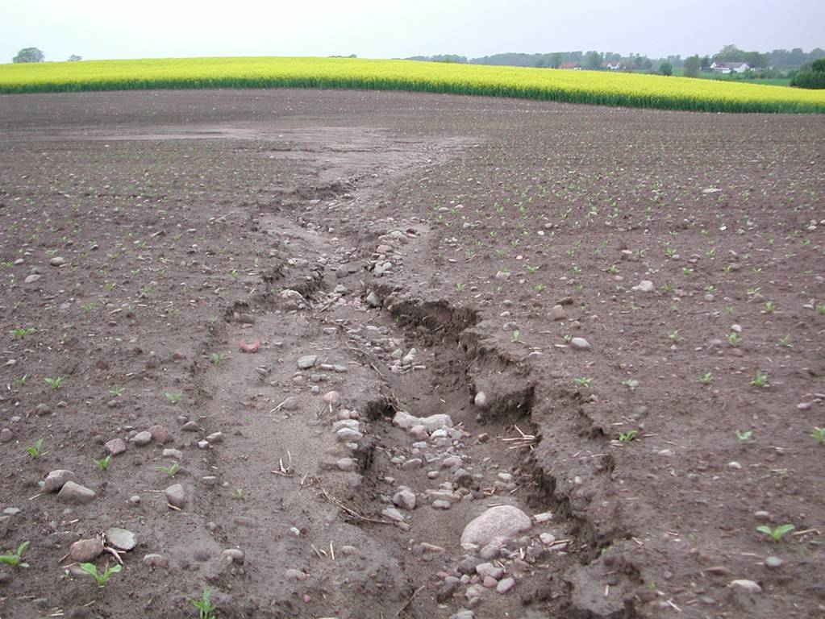
Erosion

Slide 21
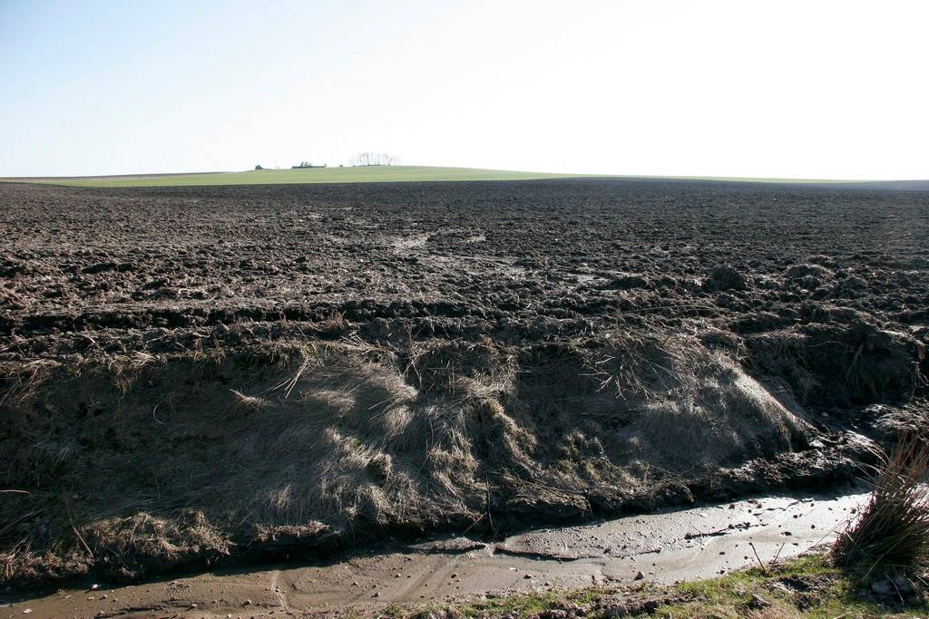
Erosion – nutrient transport

Slide 22
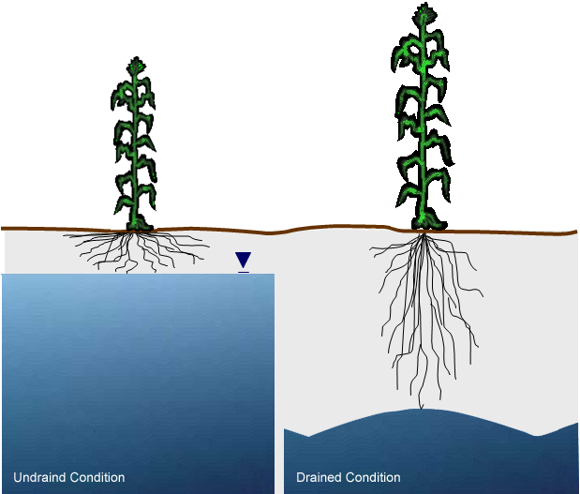
Drainage to control water logging
Combination of soils and climate create need

Slide 23
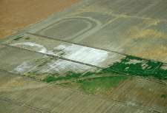
Drainage to control salinization
Salinization is the accumulation of soluble salts at the soil surface, or at some point below the soil surface, to levels that have negative effects on plant growth and/or on soils.

Slide 24
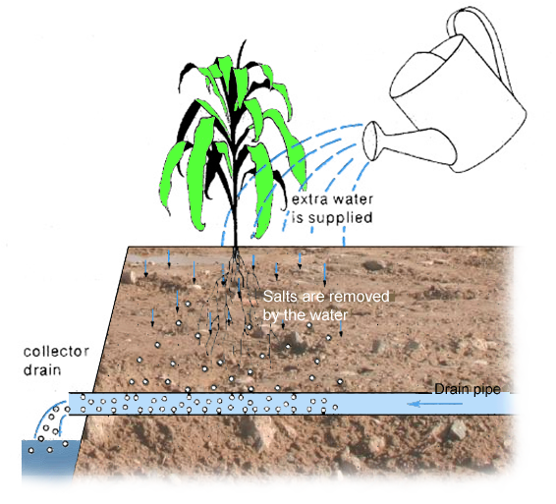
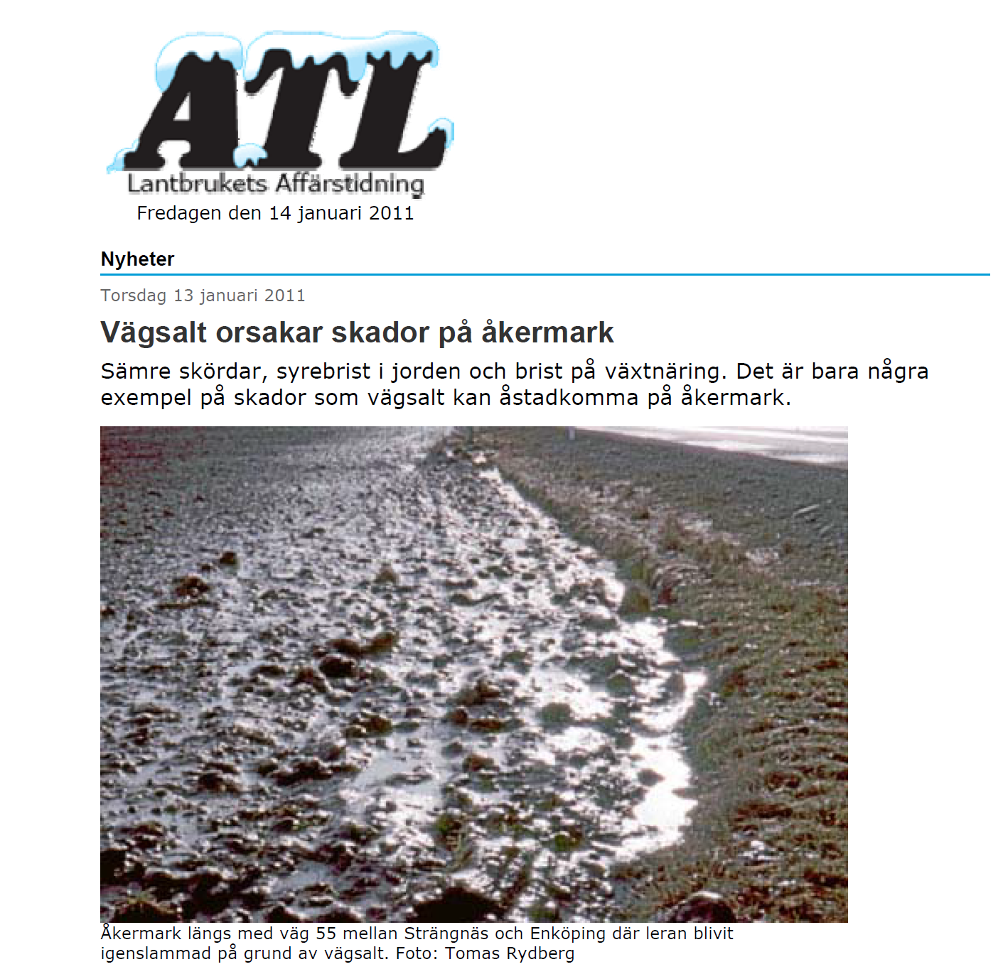
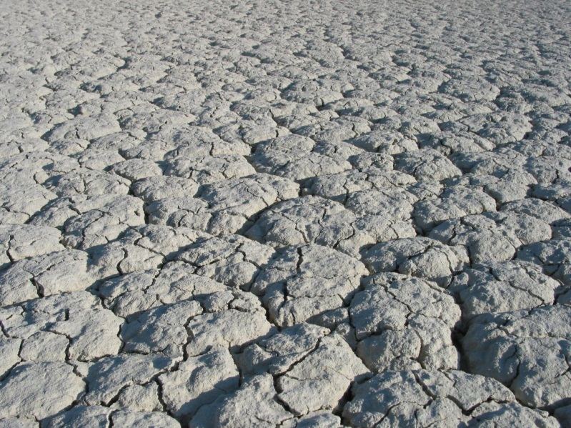
Markavvattning för att förebygga Försaltning

Slide 25
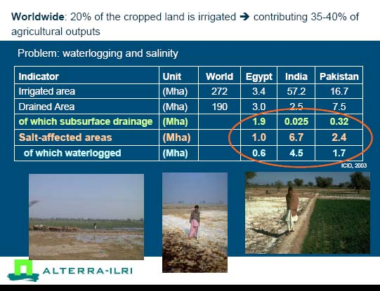
Ritzema, 2008

Slide 26
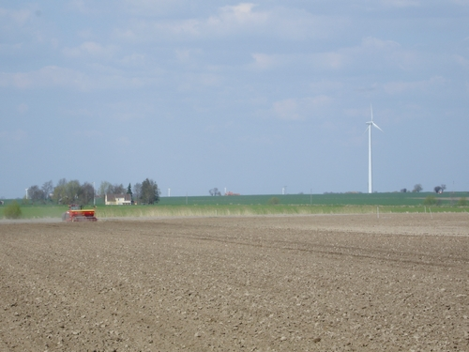
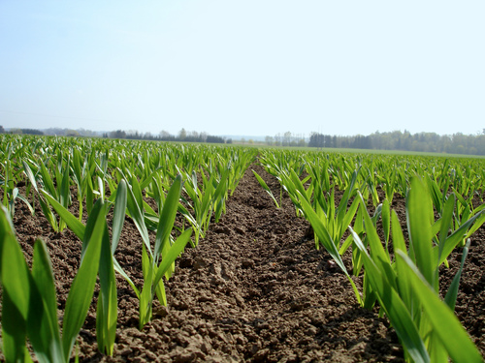
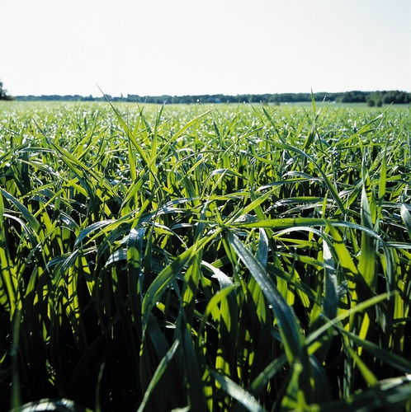
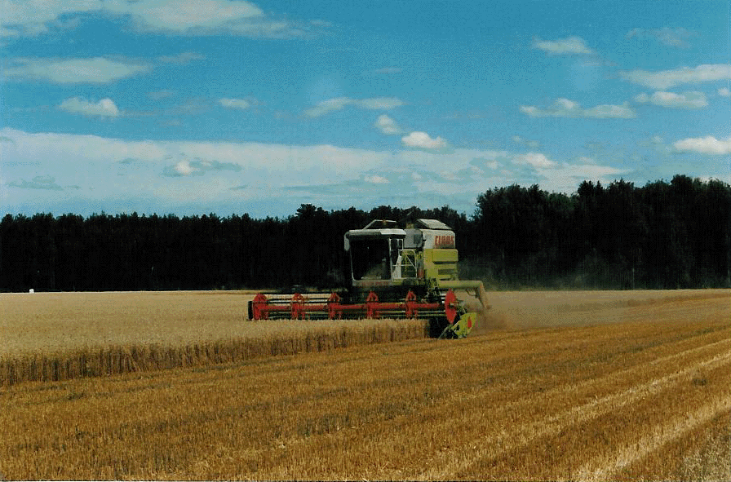
Fast and even drying
Even establishment
Good development, good root environment
Good bearing capacity

Slide 27
Why drainage?
The aim of agricultural land drainage is to optimize agricultural production related to:
conservation of agricultural land
reclamation of agricultural land
optimization of crop yield
crop diversification
cropping intensification
optimization of farm operations

Slide 28
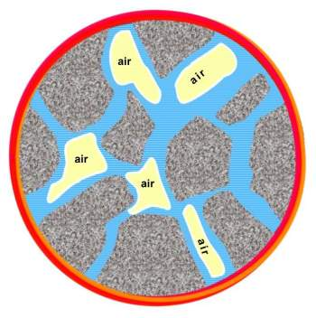
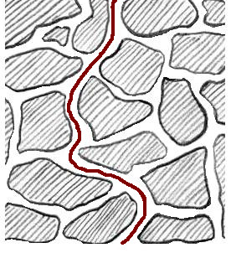
Pore system in soil
Ratio of air and water in the pore system
Pore size distribution
Continuity and tortuosity
Storage and conductivity of water
Gas exchange
Storage and conductivity of heat
Possibility of root development

Slide 29
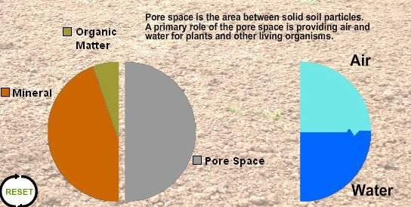
Optimum composition for most crops

Slide 30
Environmental impacts of drainage
Impact of drainage on soil conditions
  Physical effects
  Biological effects
  Chemical effects
Hydrological impact of a drainage system
Water quality impacts

Slide 31
Environmental impacts of drainage
Installation of drainage system
Direct effects
Lower groundwater levels
Dryer soils
Indirect effects
Physical
Hydrological
Biological
Chemical

Slide 32
Impact of drainage on soil conditions
Soil physical impacts
soil aeration
soil structure and consistency
soil temperature
irreversible shrinkage (gyttja soil)
subsidence (peat soils)

Slide 33
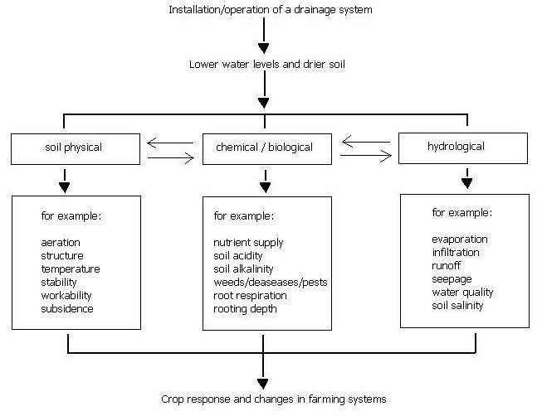
Environmental impacts of drainage
Oosterbaan, 1994

Slide 34
Soil Aeration
Process of Soil Aeration
Characterizing Soil Aeration
Factors Affecting Soil Aeration
Ecosystem Effects of Soil Aeration

Slide 35
I. Process of Soil Aeration
O₂ availability in field
  soil macroporosity (texture/structure)
  soil water content (proportion of porosity filled with air)
  O₂ consumption by respiring organisms (plant roots and microbes)
Excess Moisture
  water saturated/waterlogged: condition when all or nearly all of the soil pores are filled with H₂O
  adaption
Gas exchange
  mass flow
  diffusion

Slide 36
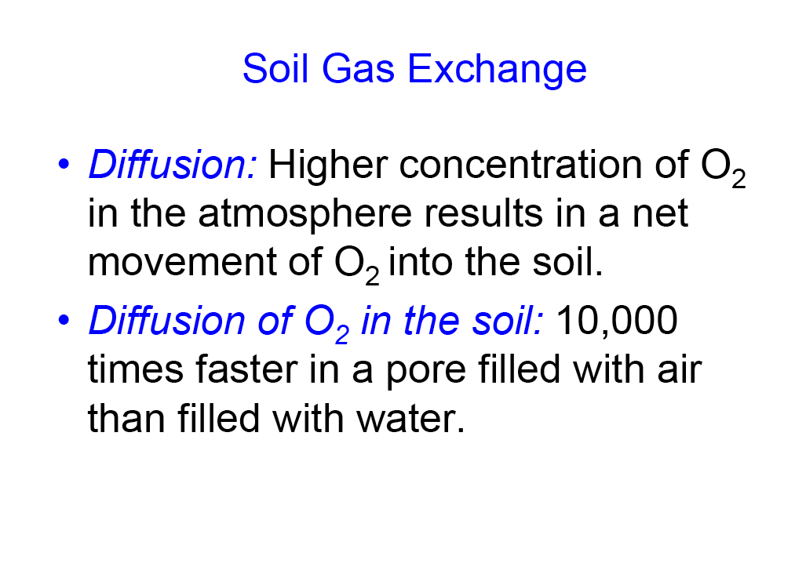
Soil gas exchange

Slide 37
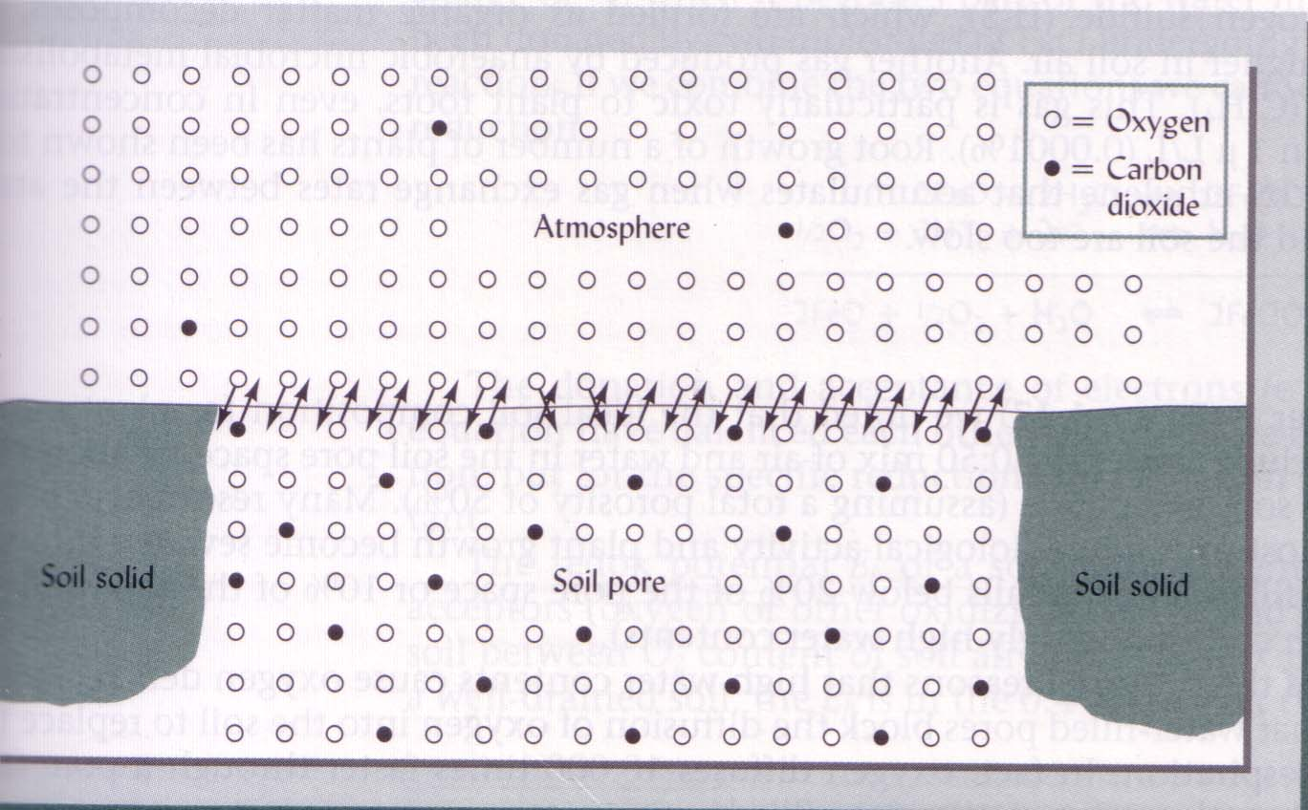
Diffusion

Slide 38
Demand - Storage
Demand: Productive crop, one cropping season (coarse estimation)
Water | 4 000 000 kg ha⁻¹ | 4 000 m³ ha⁻¹
Oxygen | 8 000 kg ha⁻¹ | 10 000 m³ ha⁻¹
Nitrogen | 200 kg ha⁻¹
Ca 20 % oxygen in air→ 50 000 m³ ha⁻¹
Assumption: Available water 200 mm → 2 000 m³ ha⁻¹
Available air → 1 000 m³ ha⁻¹
Crop demand: 2 storages of water
50 storages of air
Oxygen will last 2 to 3 days!

Slide 39
II. Characterizing Soil Aeration
Composition
  O₂
  CO₂
  other gases
Air-filled porosity
  ideal composition
  O₂ diffusion through water<<<<<air
Chemical redox potential
  redox
  role of O₂
  other e⁻ acceptors

Slide 40
Composition of soil air (Volume%)
 | N₂ | O₂ | CO₂ | CH₄
Atmosphere | 78 | 21 | 0,035 | Trace
Soil air | 78 | 20 (0-20%) | 0,35 (0-5%) | Trace

Slide 41
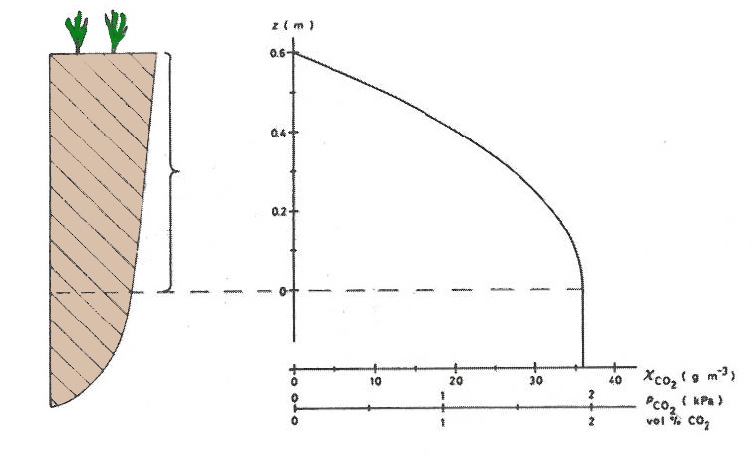
Composition of soil air
CO₂- concentration in soil
After Koorevaar et al., 1983

Slide 42
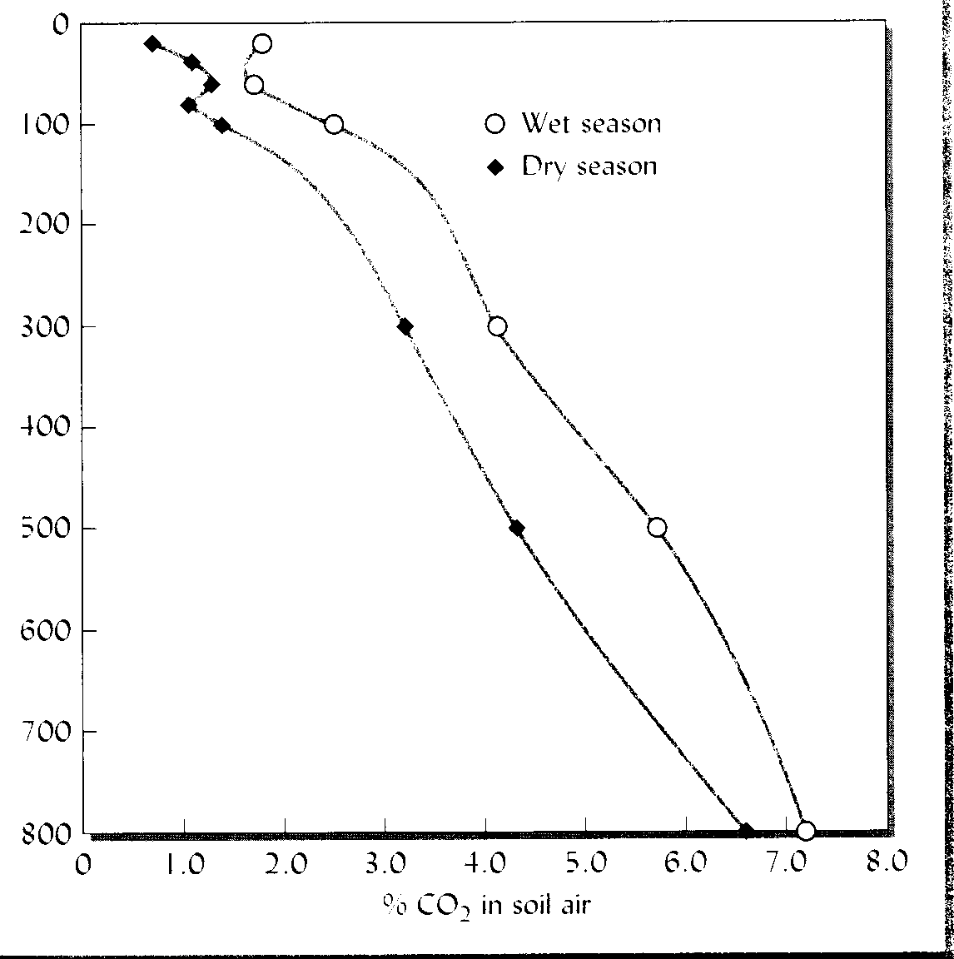
CO₂ content in soil

Slide 43
II. Characterizing Soil Aeration
Composition
  O₂
  CO₂
  other gases
Air-filled porosity
  ideal composition
  O₂ diffusion through water<<<<<air

Slide 44
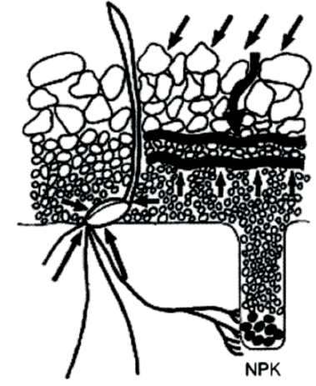
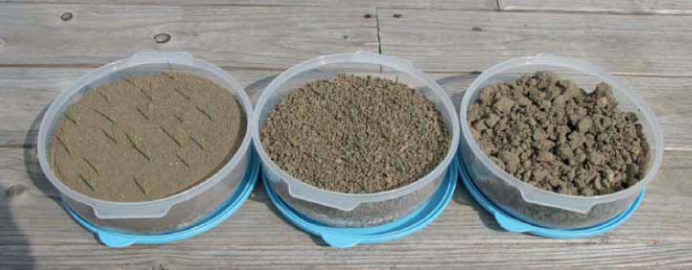
Ideal seed bed
Foto: Jens Blomqvist
Notes:
Vad krävs för ett frö ska gro?
lämplig temperatur
tillräcklig syre och vattentillgång
friskt utsäde med bra energiinnehåll och frö som inte är skadade,
inga grobarhetshämmande substanser som försvårar groningen.
Därtill kommer ytterligare krav för grödans uppkomst.
Avståndet från frö till markytan får inte vara för långt eftersom energireserven hos fröet är begränsande
det får heller inte vara ett alltför kraftigt mekaniskt motstånd mot plantan vid tillväxt
får inte plantorna utsättas för skadedjur, sjukdomar eller fysisk samt kemisk påverkan (Håkansson, m.fl., 2010a)

Slide 45
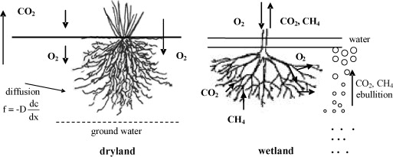
Soil aeration
Diffusion coefficient (m² s⁻¹)
Substance | O₂ | CO₂
Air | 2,3 • 10⁻¹ | 1,8 • 10⁻¹
Water | 2,6 • 10⁻⁵ | 2,0 • 10⁻⁵
Notes:
Atmosfären: 78 % N₂, 21 % O₂, 0,035 % CO₂
Markluft O₂ ~20 % vid ytan till < 5 % längre ned i profilen
Låg O₂ anaerobiskt (blöta jordar)
CO₂ halter ofta 0,35 % ~ 10 ggr högre än i atmosfären
Transportprocesser
Konvektivt flöde (massflöde); drivkraft en gradient i totalt gastryck.
Diffusion; drivkraft en gradient i partialtryck (eller koncentration).

Slide 46
III. Factors Affecting Soil Aeration
Drainage
Rates of respiration
Subsoil vs. topsoil
Soil heterogeneity
Seasonal differences
Effects of vegetation

Slide 47
Factors Affecting Soil Aeration
Drainage
  Why are macropores important to soil aeration?
Rates of respiration
  2. What management activities can alter soil air composition?
Subsoil vs. topsoil
  3. Why do subsoils have lower O₂ concentrations than surface soils?

Slide 48
Factors Affecting Soil Aeration
D. Soil heterogeneity
  How do O₂ and CO₂ concentrations change within a profile?
  What effect does tillage have on aeration?
E. Seasonal differences
  6. Contrast spring vs. summer soil aeration.
F. Effects of vegetation
  7. What is an effect of one specific type of vegetation on soil aeration?

Slide 49
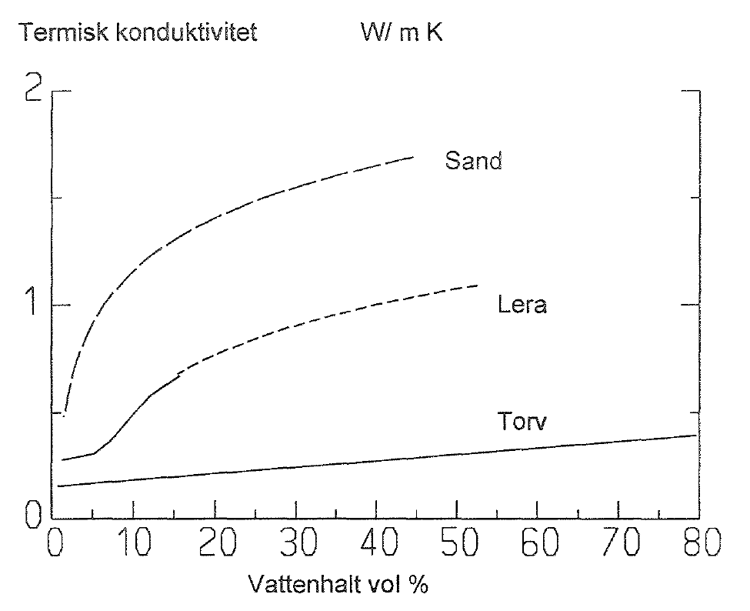
Storage and heat conductivity
Substans | Heat capacity (MJ m⁻³ ⁰C⁻¹) | Heat conductivity (W m⁻¹ ⁰C⁻¹)
Quartz | 2,0 | 8,8
Other minerals | 2,0 | 2,9
Organic material | 2,5 | 0,25
Water | 4,2 | 0,57
Ice | 1,9 | 2,2
Air | 0,0013 | 0,025
Sand
Clay
OM
Water content (vol%)
Notes:
I det fall då vi har en helt uttorkad kvartssand kommer värmeöverföringen att ske 220 ggr så effektivt i partiklarna som mellan partiklar, separerade av luft. Om istället kontaktytorna mellan partiklarna är utfyllda med vatten
blir motsvarande siffra 16.
Effekten av vattenhalten på den termiska konduktiviteten är vanligtvis mindre betydelsefull i lerjordar eftersom de l) sällan torkar ut så starkt och 2) ej innehåller kvarts. Till skillnad från sandjorden finns i leran ingen, eller en mycket liten, direkt kontakt mellan mineralen. Alla mineral i ett aggregat kan dock betraktas som i det närmaste helt inneslutna i vatten. Vattnet blir därför så gott som alltid kontinuerligt medium i en lerjord. Vid stark upptorkning uppkommer sprickor mellan aggregaten men dessa sprickor får ibland en parallell orientering med värmeflödet. Dessutom kan kontakten mellan enskilda lerpartiklar förbättras i aggregaten eftersom de förs närmare varandra i samband med krympningen. Vi kan således förvänta oss betydligt mindre variationer i termisk konduktivitet för lerjordar och lägre maximala värden på grund av frånvaron av kvarts.
I en ren organogen jord kommer vattnet att få en högre termisk konduktivitet än det fasta materialet. Vattnet kan här i likhet med förhållandena i lerjorden betraktas som kontinuerligt medium, men eftersom inget annat material än vattnet självt kan förväntas att bidraga till markens förmåga att leda värme.

Slide 50
Impact of drainage on soil conditions
Biological effects
plant establishment
root development
macroorganisms and microorganisms
mineralisation
nitrification
denitrification

Slide 51
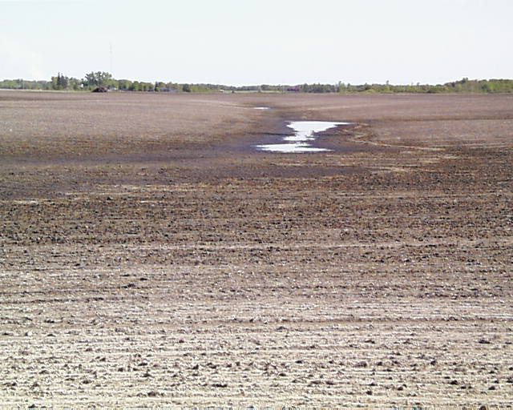
Wheat (winter) Emergence
100
80
Percent of seeds producing seedlings
A similar, dramatic
curve exists
for other crops
0
0
4
8
20
Duration of water logging between
germination & emergence, (days)

Slide 52
Rooting depth

Slide 53
Drainage distance – drainage effects
Tile
Tile
Drainage distance 96 m
Parcell harvest in a drainage trial with different drainage distance at Gunnarstorp 1949-1968, Skaraborgs län, crop winter wheat
Håkansson et al., 1974
Notes:
53

Slide 54
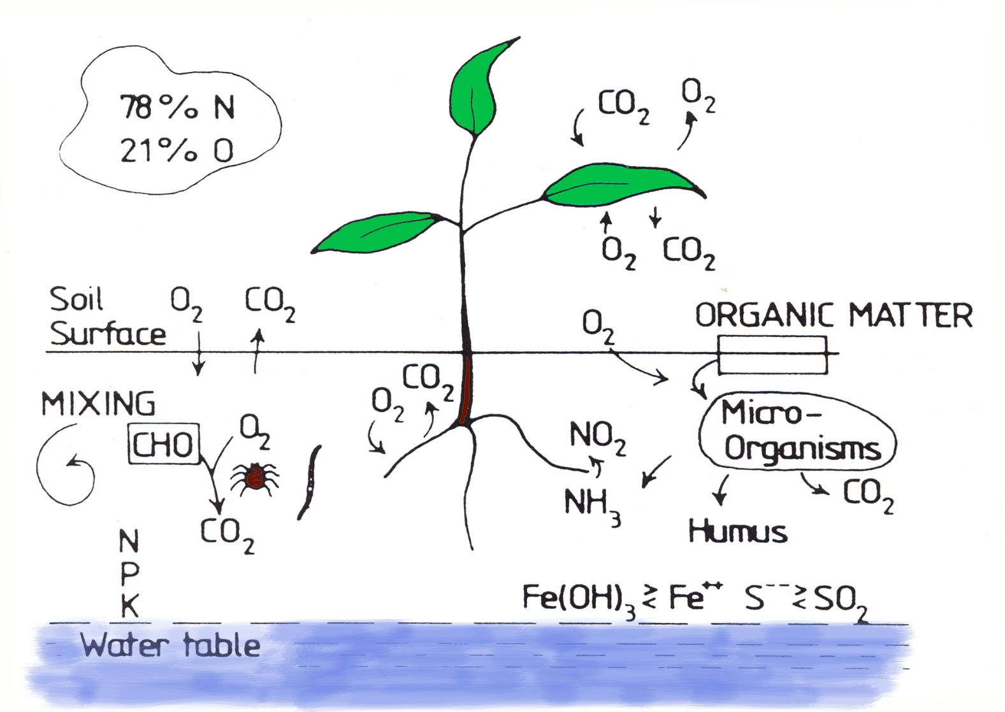
Aerobic processes in arable soil
After McAfee, 1989

Slide 55
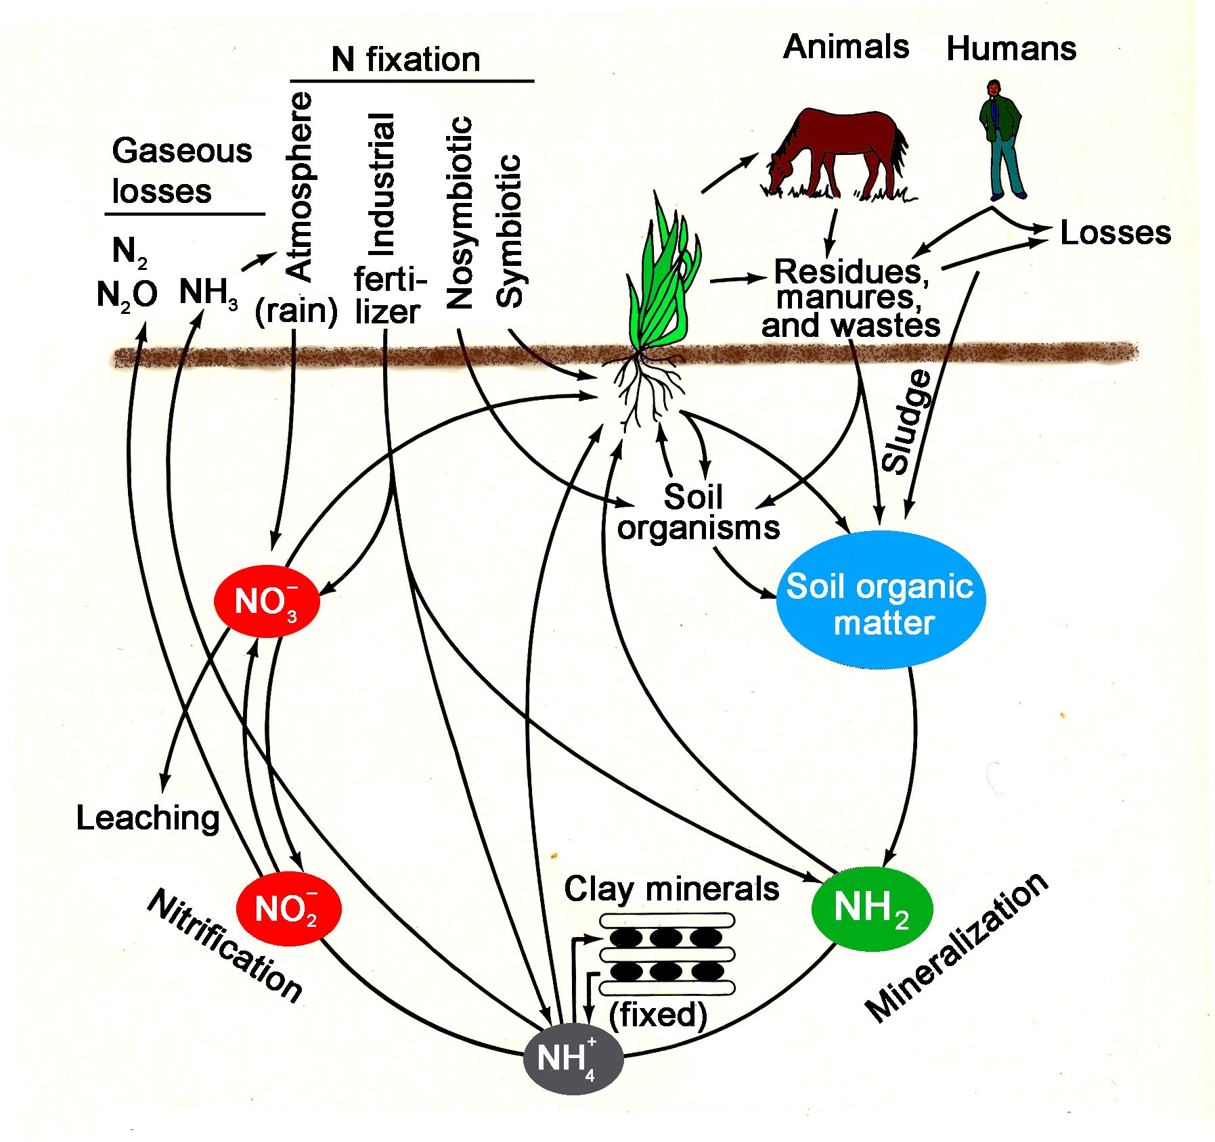
Nitrogen flows
After Brady, 1984

Slide 56
Impact of drainage on soil conditions
Chemical effects
reduction/oxidation state
pH
solubility of elements

Slide 57
What is oxidation and reduction?
Oxidation and reduction are chemical reactions involving the exchange of electrons from one compound to another
Oxidation and reduction always happen together - when one compound loses an electron, another compound gains it
  Oxidation happens when electrons are lost
  Reduction happens when electrons are gained

Slide 58
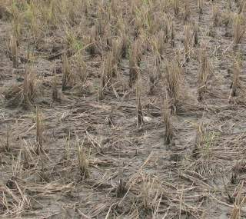
Oxidation and reduction in an aerobic setting
  4 e⁻ + O₂ + 4 H⁺→ 2 H₂O
Organic matter in soil gives up 4 electrons (e⁻) which are received by O₂. As a result, O₂ is reduced.
Hydrogen ions (H⁺) react with the reduced O₂ to form water (H₂O).

Slide 59
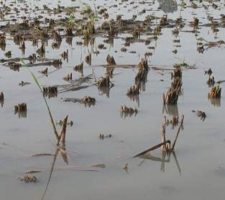
Oxidation and reduction in an anaerobic setting
  10 e⁻ + 2 NO₃⁻ + 12 H⁺→ 1 N₂ + 6 H₂O
Electrons (e-) from organic matter in soil are accepted by nitrate (NO₃⁻) instead of O_{2.}
Nitrogen (N) in NO₃⁻ is reduced; the N compound becomes nitrogen gas (N₂)
Hydrogen ions (H⁺) react with oxygen from NO₃⁻ to produce H₂O.

Slide 60
Summary slide
Organisms get energy for life through respiration
Respiration involves an exchange of electrons.
  One compound gains electrons (reduction)
  Another compound loses electrons (oxidation)
Carbon compounds consumed by organisms are oxidized and the electrons are gained by
  O₂ in aerobic soil
  Chemical compounds like nitrate or sulfate in anaerobic soil

Slide 61
Chemical Reduction Sequence Following Submergence
O₂
Oxidized
NO₃⁻
H₂O
Slightly Reduced
N₂
MnO₂
Mn²⁺
Moderately Reduced
Fe³⁺
Fe²⁺
Strongly Reduced
SO₄⁻²
CO₂
H₂S
CH₄
Reaction sequence following submergence
Reaction sequence after draining
Notes:
The boxes represent different chemical compounds in the soil. When the soil is aerated, the chemical compounds in the soil will be represented by the top set of boxes. The bottom set of boxes represent the chemical compounds in the soil after they are reduced. As you click on the slide (in presentation view), you can see the order in which the compounds are reduced and the change in form. The sequence of the compounds from left to right is the order in which they will be reduced starting with oxygen and ending with carbon dioxide.
When a soil is drained, oxygen begins to move into the soil and react with the reduced compounds. The reduced compounds are then oxidized in the reverse sequence starting on the right and moving to the left.

Slide 62
Form of compounds in aerated versus submerged soil
Element | Aerated soil (Oxidized) | Submerged soil (Reduced)
Oxygen (O) | Oxygen gas (O₂) | Water (H₂O)
Nitrogen (N) | Nitrate ion (NO₃⁻) | Nitrogen gas (N₂)
Manganese (Mn) | Manganese IV ion (Mn⁴⁺) | Manganese II ion (Mn²⁺)
Iron (Fe) | Iron III ion (Fe³⁺) | Iron II ion (Fe²⁺)
Sulfur (S) | Sulfate ion (SO₄²⁻) | Hydrogen sulfide (H₂S)
Carbon (C) | Carbon dioxide (CO₂) | Methane (CH₄)

Slide 63
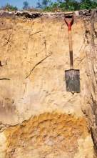
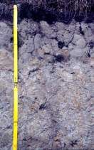
Chemistry and color
Well-drained soil profile
A change in chemistry results in a change of soil color
  bright colors indicate a well-drained soil
  submerged soils change to a gray or blue-green color (often referred to as gley)
Why is this?
  Reddish-yellowish brown colors are an indication of iron oxides in a well-drained environment
  Submergence causes iron to be reduced resulting in a different iron form and the gley color
Poorly drained soil profile

Slide 64
Submergence affects soil pH
Soil pH is a measurement of hydrogen ions in the soil and it indicates whether soil is acidic or basic.
Submergence of soil typically causes a shift towards a more neutral soil pH. This is a result of the change in chemical compounds when soil is reduced

Slide 65
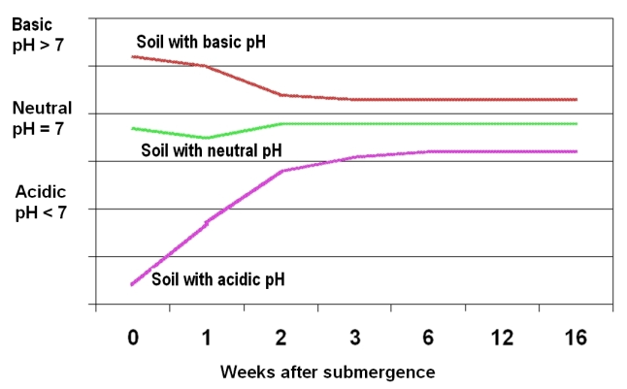
Effect on soil pH when soils are submerged

Slide 66
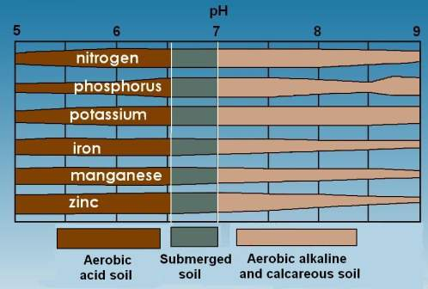
Availability of nutrients at different pH levels
The typical pH range for many submerged soils is 6.5-7. The 6 important crop nutrients in this chart are collectively more available at 6.5-7 compared to more acidic or basic pH values.

Slide 67
Summary slide
In submerged soil, chemical compounds are reduced during respiration of anaerobic microorganisms
Compounds are reduced in order based on the amount of energy needed – nitrate is first because the least energy is required
This reduction process causes a shift in the chemical compounds found in submerged soil
This change in chemical compounds results in other changes such as soil color, soil pH, and availability of nutrients for plants

Slide 68
Oxidation och reduktion under Aerobiska förhållanden
  4 e⁻ + O₂ + 4 H⁺→ 2 H₂O
Organiskt material avger 4 elektroner (e⁻) vilka tas upp av O₂ som reduceras.
Vätejoner (H⁺) reagerar med det reducerade O₂ och bildar vatten (H₂O).

Slide 69
Oxidation och reduktion under Anaerobiska förhållanden
  10 e⁻ + 2 NO₃⁻ + 12 H⁺→ N₂ + 6 H₂O
Elektroner (e-) från organiskt material tas upp av nitrat (NO₃⁻) istället för av O₂
Kvävet (N) i NO₃⁻ reduceras; Slutprodukten av N blir kvävgas (N₂)
Vätejoner (H⁺) reagerar med syret från NO₃⁻ och bildar H₂O

Slide 70
Kemisk reduktionssekvens som följer efter vattenmättad av jord
O₂
Oxidation
NO₃⁻
H₂O
Något Reducerande
N₂
MnO₂
Mn²⁺
Måttligt Reduktion
Fe³⁺
Fe²⁺
Starkt Reducedande
SO₄⁻²
CO₂
H₂S
CH₄
Reaktionssekvens efter vattenmättnad
Reaktionssekvens efter dränering
Notes:
The boxes represent different chemical compounds in the soil. When the soil is aerated, the chemical compounds in the soil will be represented by the top set of boxes. The bottom set of boxes represent the chemical compounds in the soil after they are reduced. As you click on the slide (in presentation view), you can see the order in which the compounds are reduced and the change in form. The sequence of the compounds from left to right is the order in which they will be reduced starting with oxygen and ending with carbon dioxide.
When a soil is drained, oxygen begins to move into the soil and react with the reduced compounds. The reduced compounds are then oxidized in the reverse sequence starting on the right and moving to the left.

Slide 71
Aeroba versus anaeroba förhållanden
Ämne | Aerob mark (Oxiderad) | Anaerob mark (Reducerad)
Syre (O) | Syrgas (O₂) | Vatten (H₂O)
Kväve (N) | Nitrat-jon (NO₃⁻) | Kvävgas (N₂)
Mangan (Mn) | Mangan IV jon (Mn⁴⁺) | Mangan II jon (Mn²⁺)
Järn (Fe) | Järn III jon (Fe³⁺) | Järn II jon (Fe²⁺)
Svavel (S) | Sulfat-jon (SO₄²⁻) | Vätsulfid (H₂S)
Kol (C) | Koldioxid (CO₂) | Metan (CH₄)

Slide 72
Effekter på pH i marken när sura, neutral, och basiska jordar är anaeroba
Basisk
Jord med högt pH
Jord med neutralt pH
Sur
Jord med lågt pH
Antal veckor efter översvämning

Slide 73
Växttillgänglighet av ämne vid olika pH

Slide 74
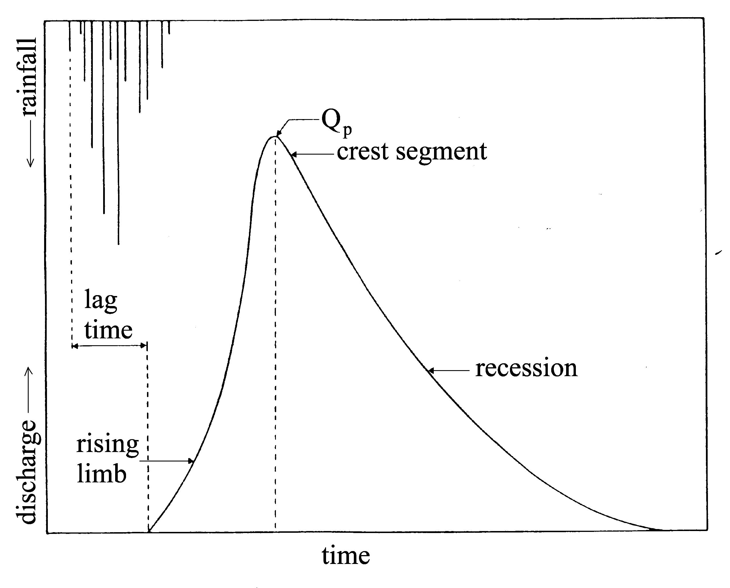
Hydrological impact of a drainage system
partition of runoff
runoff event; lag time, peak outflow rate, base flow and total outflow

Slide 75
Hydrological impact
Outflow volume
  Land development involving drainage and conversion to agriculture INCREASES total annual outflows by about 10-20 percent

Slide 76
Outflow volume
  Controlled drainage may REDUCE outflows
  to pre-development amounts, (Depends on management intensity)

Slide 77
Hydrological impact
Peak Outflow Rates
  Land development involving drainage and conversion to agriculture Dramatically INCREASES Peak Outflow Rates

Slide 78
Impact on water quality
Nutrient (N&P) Concentration
  Land development involving drainage and conversion to agriculture INCREASES nutrient (nitrogen and phosphorus) concentrations in outflow

Slide 79
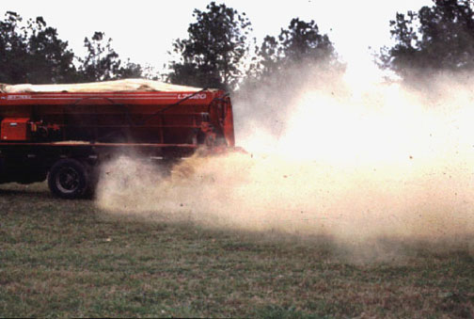
Impact on water quality

Slide 80
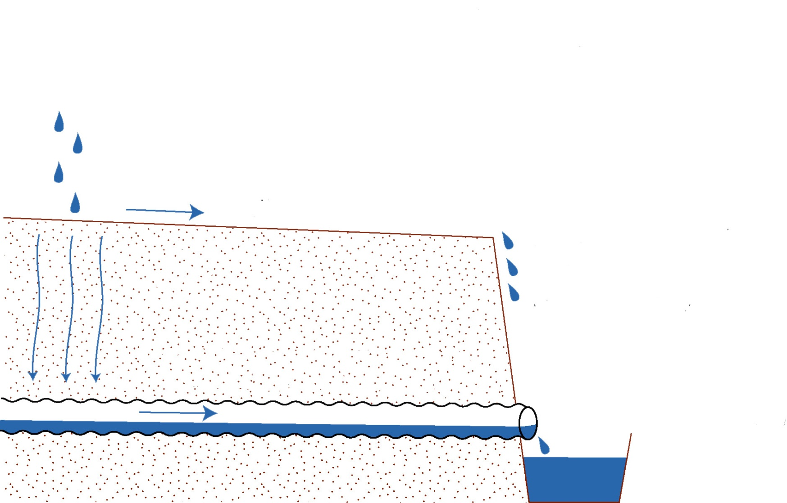

Nutrient content in outflow
Surface runoff
Particular Nitrogen (PN)
Sediments
Particular Phosphorus (PP)
Subsurface runoff
Dissolved Phosphorus (DP)
Dissolved Nitrogen (DN)
DRÄNERINGSCENTRALEN RF

Slide 81
Excess water
Large pores filled
Diffusion declines
Continued decomposition and biotic activity consume available soil oxygen
Soil oxygen content decline
Carbon dioxide content builds up
Denitrification
Increased leakage
Low redox potentials
Accumulation of
Reduced Fe and Mn
H_{x}S at toxic levels
Root damage, restricted growth
Reduced uptake of nutrients
Reduction in plant growth and yield
After Ravelo, 1978 and Patwardhan et al, 1988
Notes:
Processer i marken orsakade av ett överskott av vatten som leder till hämmad tillväxt och skörd

Slide 82
Drainage system
A field drainage system, which prevents ponding water on the field and/or controls the water table.
A main drainage system, which conveys the water away from the farm.
An outlet, which is the point where the drainage water is led out of the area.

Slide 83
Field drainage system (internal)
surface drainage system (by gravity)
conventional system
controlled system
subsurface drainage system (by gravity or pumped)
conventional system
Reglerbara system
graded land
bedded land
bunded basins
bunded terraces
subsurface, open ditches
sub soiling
Reglerbar dränering
Vertikal dränering
Dräneringssystem
Main drainage system (external)
deep collectors (pipes, ditches)
disposal drains
shallow collectors (channels, ditches)
deep main drains
Outlet
Oosterbaan, 1994

Slide 84
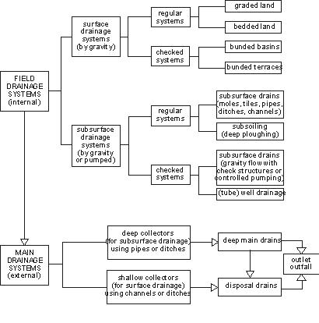
Drainage systems
Oosterbaan, 1994

Slide 85
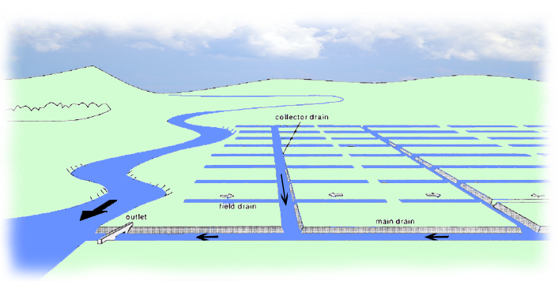
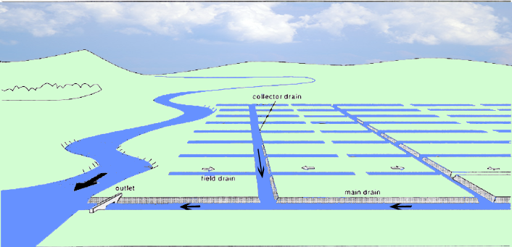
Drainage system

Slide 86
Field drainage systems
Surface drainage
  Graded land
  Bedded land
Subsurface drainage
  Pipes, tiles
  Tubewell drainage
  Mole channels
  Slit drainage
  Controlled drainage
Notes:
Methods of land drainage used on agricultural land are surface drainage, subsurface drainage, dikes with pumped drainage outlets and tubewell drainage. A surface drainage system removes excess water from the soil surface and the upper root zone in order to prevent water ponding on the soil surface.

Slide 87
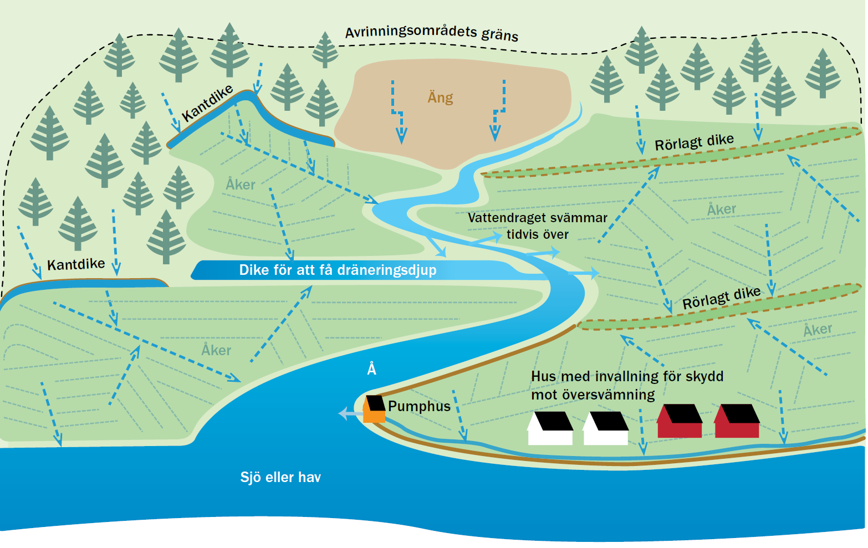
Illustration; Lena Granell

Slide 88
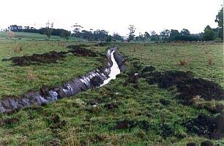
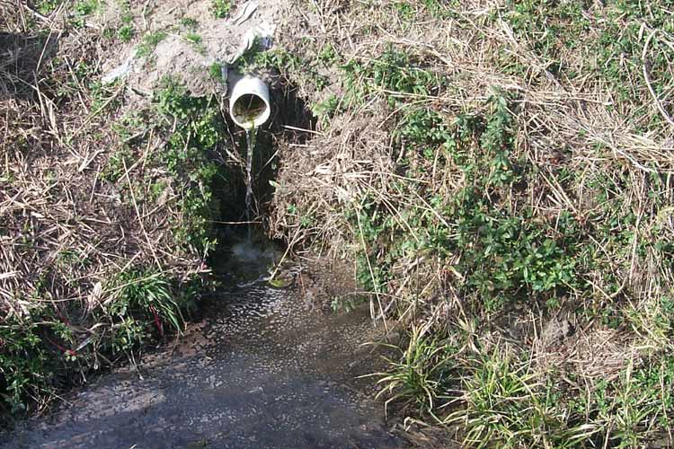
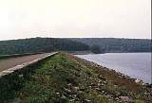
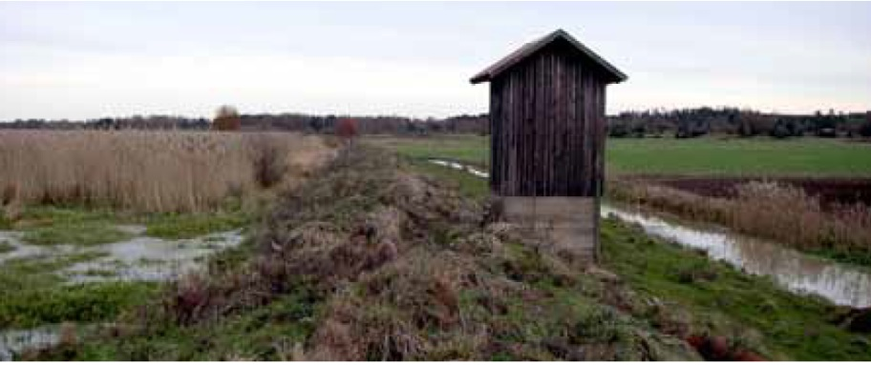
Foto: Stig Svenmar

Slide 89

Dikes
Illustration; Lena Granell

Slide 90
Surface drainage
Surface drainage is the removal of excess water from the surface of the land by diverting it into improved natural or constructed drains, supplemented, when necessary, by the shaping and grading of the land surface towards such drains.

Slide 91
Surface drainage
A surface drainage system always has two components:
Open field drains to collect the ponding water and divert it to the collector drain.
Land forming to enhance the flow of water towards the field drains.

Slide 92

Surface drainage

Slide 93

Surface drainage

Slide 94


Surface drainage

Slide 95



Surface drainage, types of drainage flows

Slide 96



Surface drainage

Slide 97
Land forming
Land forming means changing the surface of the land to meet the requirements of surface drainage or irrigation. There are three land-forming systems:
bedding
land grading
land planing

Slide 98



Land forming, bedding
Bedding is a surface drainage method achieved by ploughing land to form a series of low beds, separated by parallel field drains.

Slide 99


Land forming, land grading
Land grading is forming the surface of the land to predetermined grades, so that each row or surface slopes to a field drain.

Slide 100


Land forming, land planing
Land planing is smoothing the land surface with a land plane to eliminate minor depressions and irregularities without changing the general topography.

Slide 101

Open ditch
Foto: Anuschka Heeb

Slide 102

Half covered ditch
Foto: Anuschka Heeb

Slide 103

Pipe drained
Foto: Anuschka Heeb

Slide 104
Subsurface drainage
Subsurface drainage is the removal of excess water and dissolved salts from soils via groundwater flow to the drains, so that the water table and root-zone salinity are controlled.

Slide 105

Subsurface drainage

Slide 106

Subsurface drainage system
drainage outlet
main drainage channel
some collector drains
field or lateral drains
Notes:
The main drainage channel collects runoff from one or more collector drains. It discharges its water via a pumping station or by gravity into a river, a lake, or the sea at a suitable outlet. The main drainage channel is often a canal stream, which runs through the lowest parts of the agricultural area. Both collectors and lateral drains can be open ditches or pipe drains.

Slide 107

Subsurface drainage

Slide 108
Surface/subsurface drainage
can receive overland flow
functional at soil frost
evacuate the standing water from the rice fields
occasional high-intensity rainfall (say more than 50 mm/day)
loss of land
interference with the irrigation system
the splitting up of the land into small farm blocks, which hampers farming operations,
they are a maintenance burden.

Slide 109
Surface and Subsurface Drainage Hydrographs
0
0.1
0.2
Rain, cm / hr
0.3
0.4
Surface Drainage
Subsurface Drainage
3.0
Subsurface Drainage
Total Rainfall = 32.5 mm
2.5
Total Outflow for
Surface Drainage = 2.54 cm
Total Outflow for
Subsurface Drainage = 2.74 cm
Total Outflow for
Surface Drainage = 25.4 mm
Total Outflow for
Subsurface Drainage = 27.4 mm
2.0
1.5
Drainage Outflow, cm / day
1.0
0.5
0
10
20
30
40
50
60
70
80
90
Time, hrs

Slide 110




Controlled drainage

Slide 111




Controlled Drainage

Slide 112
Function and management
when to raise and lower the control structure
what height to maintain the weir in the control structure

Slide 113

Function and management

Slide 114
Environmental Benefits
Improve drainage water quality
Controlled drainage has been recognized as a best management practice (BMP)
Reduce nitrates leaving the site by up to 50% compared to conventional drainage
Improves the off-site water quality in terms of herbicides, pesticides, sediments and other nutrients

Slide 115
Economics
higher initial cost than a conventional drainage system.
potential for higher yields,
less varied yield results
lower operational cost
require more attention to properly manage the water table level

Slide 116
Agricultural drainage systems can be beneficial both from an agricultural and an environmental point of view

Slide 117
Tube well Drainage systems
Controlling the watertable and salinity by pumping from a series of wells
Water is discharged into open ditches

Slide 118

Tube well Drainage systems
Boehmer and Boonstra, 1994

Slide 119


Vertical drainage systems
Areas with Artesic water

Slide 120
Tube well Drainage systems
Less total length
Excessive earth moving is avoided
Less to maintain
Watertable may be lower to much greater depth
Reduce artesian pressure
Water may be used for irrigation
More costly to maintain and operate
Energy requirement
Legal regulations
Not economically feasible in small areas
Salt content of drainage water can be higher

Slide 121
Mole Drainage systems
Heavy soils of low hydraulic conductivity (< 0.01 m/day)
Unlined circular soil channels
Low costs
Restricted functional time

Slide 122

Mole drainage

Slide 123


Mole drainage
http://www.tgdrains.com.au/

Slide 124


Mole drainage

Slide 125

Mole drainage

Slide 126
Mole Drainage systems
Clay content > 45%
Structured stability on wetting
Timing on moling operation (best during dry period)
Moling depth (commonly 0.4 - 0.7 m)
Moling drain spacing (closer that required 2 to 3.5 m)
Length of mole run (commonly 20 to 100 m)

Slide 127
Slit drainage
Surface drainage can be improve by slit drainage
A series of 5-7 cm wide and 40–60 cm deep, cut directly in the surface and filled with a course, free-draining material. Normal cc-distances are from 0,5 m and forward depending on need.
Important is that these slits have a direct connection to an underground pipe network. The slits lay out are usually right across the pipes.

Slide 128


Slit drainage
Slits 5-7 cm wide
S
50 cm > apart
40-60 cm deep
After http://www.lancoturf.com/cadre-slit.htm

Slide 129

Slit drainage

Slide 130

Slit drainage

Slide 131

Controlled drainage
bild: Jord- och skogsbruksministeriet 2000

Slide 132
Management of drainage water
Improve water quality
Reduce outflow
Reuse of drainage water

Slide 133
Characteristics of drainage water quality
Salts and major ions
Toxic trace elements
Agropollutants
Sediments

Slide 134
Water quality concerns for water uses
Crop production
Living aquatic resources, fisheries and aquaculture
Livestock production
Concerns for human health

Slide 135
Management of drainage water
Improve water quality
Cropping patterns
Use of agricultural inputs
Drainage techniques and design

Slide 136
Management of drainage water
Reduce outflow
Irrigation and drainage management
Drainage techniques and design

Slide 137
Management of drainage water
Reuse of drainage water
Reuse in conventional crop production
Crop substitution and reuse for irrigation of salt tolerant crops
Reuse in Integrated Farm Drainage Management systems (IFDM systems)

Slide 138

Management of drainage water
Reuse of drainage water for crop production
FAO Irrigation and Drainage paper 61, 2002

Slide 139

Management of drainage water irrigation of salt tolerant crops
FAO Irrigation and Drainage paper 61, 2002

Slide 140

Management of drainage water
Reuse in IFDM systems
FAO Irrigation and Drainage paper 61, 2002

Slide 141

Management of drainage water
Reuse in IFDM systems
FAO Irrigation and Drainage paper 61, 2002

Slide 142


Slide 143


