Slide 1
Introduction to Grid Computing
By
Dr. Ntalindwa Theoneste

Slide 2
Overview
Background: What is the Grid?
Related technologies
Grid applications
Communities
Grid Tools
Case Studies

Slide 3
What is a Grid?
Many definitions exist in the literature
Early defs: Foster and Kesselman, 1998
  “A computational grid is a hardware and software infrastructure that provides dependable, consistent, pervasive, and inexpensive access to high-end computational facilities”
Kleinrock 1969:
  “We will probably see the spread of ‘computer utilities’, which, like present electric and telephone utilities, will service individual homes and offices across the country.”

Slide 4
3-point checklist (Foster 2002)
Coordinates resources not subject to centralized control
Uses standard, open, general purpose protocols and interfaces
Deliver nontrivial qualities of service
  e.g., response time, throughput, availability, security

Slide 5
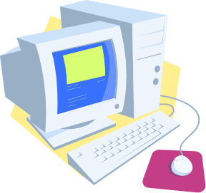

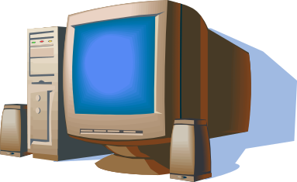

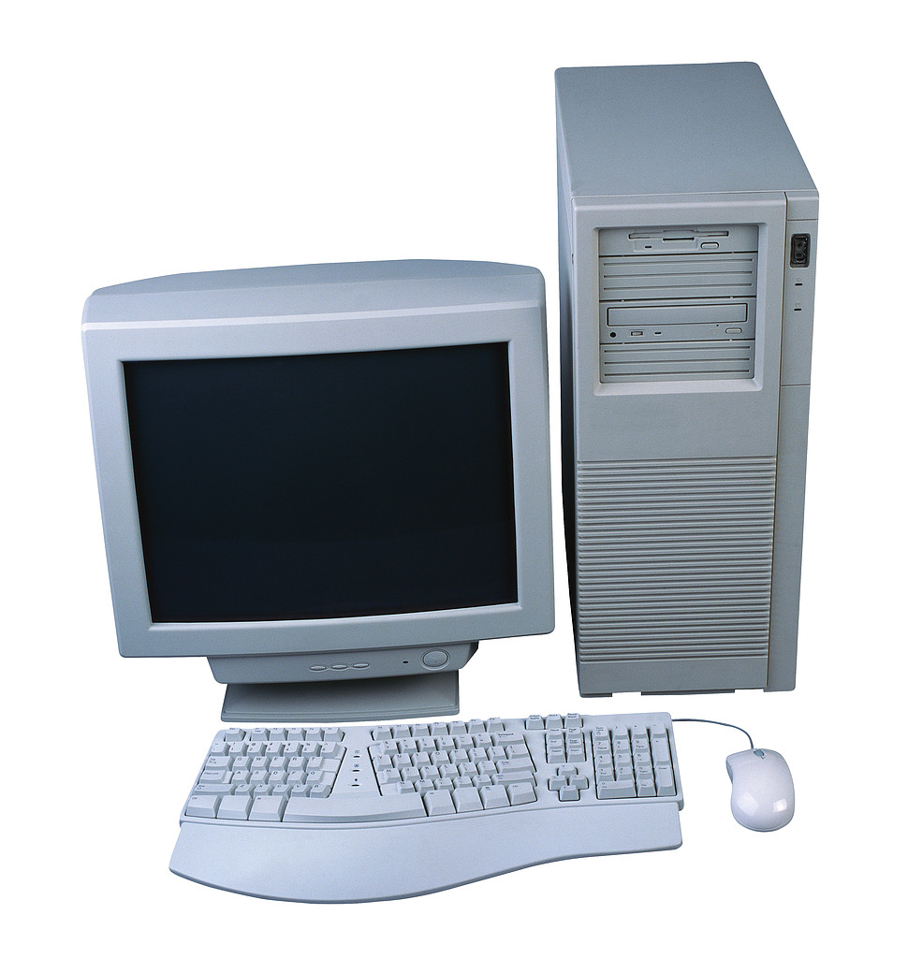
Grid Architecture
Autonomous, globally distributed computers/clusters

Slide 6
Why do we need Grids?
Many large-scale problems cannot be solved by a single computer
Globally distributed data and resources

Slide 7
Background: Related technologies
Cluster computing
Peer-to-peer computing
Internet computing

Slide 8
Cluster computing
Idea: put some PCs together and get them to communicate
Cheaper to build than a mainframe supercomputer
Different sizes of clusters
Scalable – can grow a cluster by adding more PCs

Slide 9
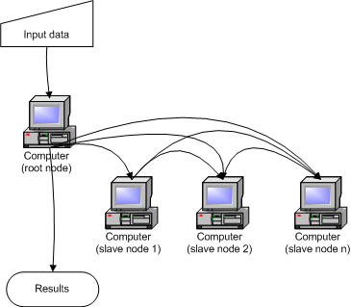
Cluster Architecture

Slide 10
Peer-to-Peer computing
Connect to other computers
Can access files from any computer on the network
Allows data sharing without going through central server
Decentralized approach also useful for Grid

Slide 11
Peer to Peer architecture

Slide 12
Internet computing
Idea: many idle PCs on the Internet
Can perform other computations while not being used
“Cycle scavenging” – rely on getting free time on other people’s computers
Example: SETI@home
What are advantages/disadvantages of cycle scavenging?
Notes:
A technique that makes use of instruction cycles on desktop computers that would otherwise be wasted at night,during lunch, or even in the scattered seconds throughout the day when the computer is waiting for user input or slow devices

Slide 13
Some Grid Applications
Distributed supercomputing
High-throughput computing
On-demand computing
Data-intensive computing
Collaborative computing

Slide 14
Distributed Supercomputing
Idea: aggregate computational resources to tackle problems that cannot be solved by a single system
Examples: climate modeling, computational chemistry
Challenges include:
  Scheduling scarce and expensive resources
  Scalability of protocols and algorithms
  Maintaining high levels of performance across heterogeneous systems

Slide 15
High-throughput computing
Schedule large numbers of independent tasks
Goal: exploit unused CPU cycles (e.g., from idle workstations)
Unlike distributed computing, tasks loosely coupled
Examples: parameter studies, cryptographic problems

Slide 16
On-demand computing
Use Grid capabilities to meet short-term requirements for resources that cannot conveniently be located locally
Unlike distributed computing, driven by cost-performance concerns rather than absolute performance
Dispatch expensive or specialized computations to remote servers

Slide 17
Data-intensive computing
Synthesize data in geographically distributed repositories
Synthesis may be computationally and communication intensive
Examples:
  High energy physics generate terabytes of distributed data, need complex queries to detect “interesting” events
  Distributed analysis of Sloan Digital Sky Survey data

Slide 18
Collaborative computing
Enable shared use of data archives and simulations
Examples:
  Collaborative exploration of large geophysical data sets
Challenges:
  Real-time demands of interactive applications
  Rich variety of interactions

Slide 19
Grid Communities
Who will use Grids?
Broad view
  Benefits of sharing outweigh costs
  Universal, like a power Grid
Narrow view
  Cost of sharing across institutional boundaries is too high
  Resources only shared when incentive to do so
  Grid will be specialized to support specific communities with specific goals

Slide 20
Government
Small number of users
Couple small numbers of high-end resources
Goals:
  Provide “strategic computing reserve” for crisis management
  Support collaborative investigations of scientific and engineering problems
Need to integrate diverse resources and balance diversity of competing interests

Slide 21
Health Maintenance Organization
Share high-end computers, workstations, administrative databases, medical image archives, instruments, etc. across hospitals in a metropolitan area
Enable new computationally enhanced applications
Private grid
  Small scale, central management, common purpose
  Diversity of applications and complexity of integration

Slide 22
Materials Science Collaboratory
Scientists operating a variety of instruments (electron microscopes, particle accelerators, X-ray sources) for characterization of materials
Highly distributed and fluid community
Sharing of instruments, archives, software, computers
Virtual Grid
  strong focus and narrow goals
  Dynamic membership, decentralized, sharing resources

Slide 23
Computational Market Economy
Combine:
  Consumers with diverse needs and interests
  Providers of specialized services
  Providers of compute resources and network providers
Public Grid
  Need applications that can exploit loosely coupled resources
  Need contributors of resources

Slide 24
Grid Users
Many levels of users
  Grid developers
  Tool developers
  Application developers
  End users
  System administrators

Slide 25
Some Grid challenges
Data movement
Data replication
Resource management
Job submission

Slide 26
Some Grid-Related Projects
Globus
Condor
Nimrod-G

Slide 27
Globus Grid Toolkit
Open source toolkit for building Grid systems and applications
Enabling technology for the Grid
Share computing power, databases, and other tools securely online
Facilities for:
  Resource monitoring
  Resource discovery
  Resource management
  Security
  File management

Slide 28
Data Management in Globus Toolkit
Data movement
  GridFTP
  Reliable File Transfer (RFT)
Data replication
  Replica Location Service (RLS)
  Data Replication Service (DRS)

Slide 29
GridFTP
High performance, secure, reliable data transfer protocol
Optimized for wide area networks
Superset of Internet FTP protocol
Features:
  Multiple data channels for parallel transfers
  Partial file transfers
  Third party transfers
  Reusable data channels
  Command pipelining

Slide 30
More GridFTP features
Auto tuning of parameters
Striping
  Transfer data in parallel among multiple senders and receivers instead of just one
Extended block mode
  Send data in blocks
  Know block size and offset
  Data can arrive out of order
  Allows multiple streams

Slide 31
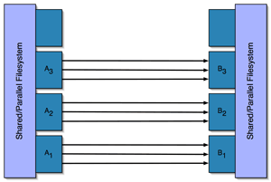
Striping Architecture
Use “Striped” servers

Slide 32
Limitations of GridFTP
Not a web service protocol (does not employ SOAP, WSDL, etc.)
Requires client to maintain open socket connection throughout transfer
  Inconvenient for long transfers
Cannot recover from client failures

Slide 33
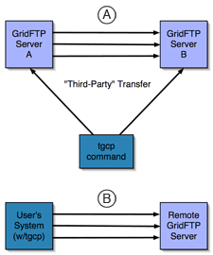
GridFTP

Slide 34
Reliable File Transfer (RFT)
Web service with “job-scheduler” functionality for data movement
User provides source and destination URLs
Service writes job description to a database and moves files
Service methods for querying transfer status

Slide 35
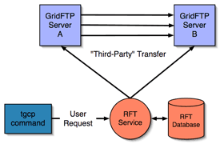
RFT

Slide 36
Replica Location Service (RLS)
Registry to keep track of where replicas exist on physical storage system
Users or services register files in RLS when files created
Distributed registry
  May consist of multiple servers at different sites
  Increase scale
  Fault tolerance

Slide 37
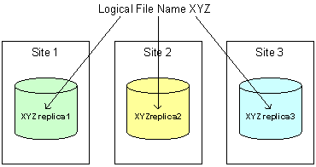
Replica Location Service (RLS)
Logical file name – unique identifier for contents of file
Physical file name – location of copy of file on storage system
User can provide logical name and ask for replicas
Or query to find logical name associated with physical file location

Slide 38
Data Replication Service (DRS)
Pull-based replication capability
Implemented as a web service
Higher-level data management service built on top of RFT and RLS
Goal: ensure that a specified set of files exists on a storage site
First, query RLS to locate desired files
Next, creates transfer request using RFT
Finally, new replicas are registered with RLS

Slide 39
Condor
Original goal: high-throughput computing
Harvest wasted CPU power from other machines
Can also be used on a dedicated cluster
Condor-G – Condor interface to Globus resources

Slide 40
Condor
Provides many features of batch systems:
  job queueing
  scheduling policy
  priority scheme
  resource monitoring
  resource management
Users submit their serial or parallel jobs
Condor places them into a queue
Scheduling and monitoring
Informs the user upon completion

Slide 41
Nimrod-G
Tool to manage execution of parametric studies across distributed computers
Manages experiment
  Distributing files to remote systems
  Performing the remote computation
  Gathering results
User submits declarative plan file
  Parameters, default values, and commands necessary for performing the work
Nimrod-G takes advantage of Globus toolkit features

Slide 42
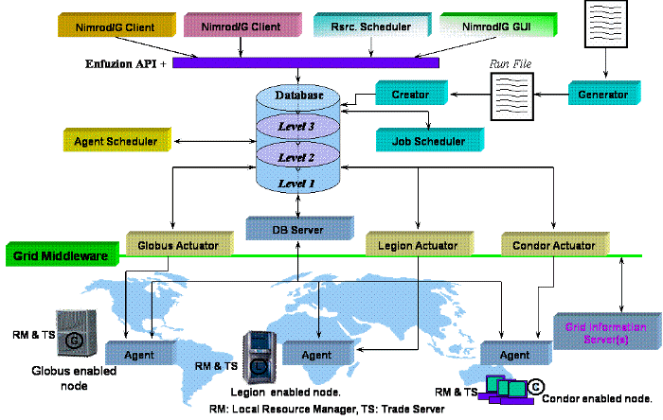
Nimrod-G Architecture

Slide 43
Grid Case Studies
Earth System Grid
LIGO
TeraGrid

Slide 44
Earth System Grid
Provide climate studies scientists with access to large datasets
Data generated by computational models – requires massive computational power
Most scientists work with subsets of the data
Requires access to local copies of data

Slide 45
ESG Infrastructure
Archival storage systems and disk storage systems at several sites
Storage resource managers and GridFTP servers to provide access to storage systems
Metadata catalog services
Replica location services
Web portal user interface

Slide 46
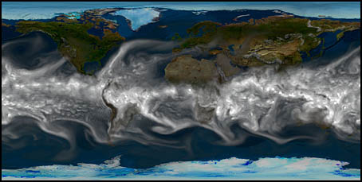
Earth System Grid

Slide 47
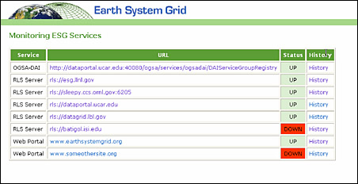
Earth System Grid Interface

Slide 48
Laser Interferometer Gravitational Wave Observatory (LIGO)
Instruments at two sites to detect gravitational waves
Each experiment run produces millions of files
Scientists at other sites want these datasets on local storage
LIGO deploys RLS servers at each site to register local mappings and collect info about mappings at other sites

Slide 49
Large Scale Data Replication for LIGO
Goal: detection of gravitational waves
Three interferometers at two sites
Generate 1 TB of data daily
Need to replicate this data across 9 sites to make it available to scientists
Scientists need to learn where data items are, and how to access them

Slide 50
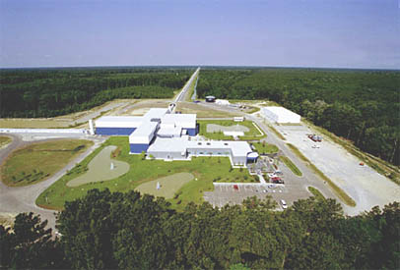
LIGO

Slide 51
LIGO Solution
Lightweight data replicator (LDR)
Uses parallel data streams, tunable TCP windows, and tunable write/read buffers
Tracks where copies of specific files can be found
Stores descriptive information (metadata) in a database
  Can select files based on description rather than filename

Slide 52
TeraGrid
NSF high-performance computing facility
Nine distributed sites, each with different capability , e.g., computation power, archiving facilities, visualization software
Applications may require more than one site
Data sizes on the order of gigabytes or terabytes

Slide 53
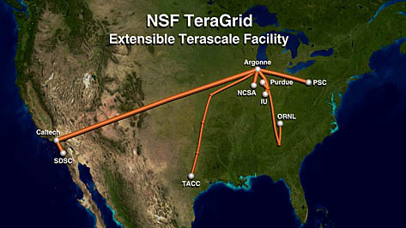
TeraGrid

Slide 54
TeraGrid
Solution: Use GridFTP and RFT with front end command line tool (tgcp)
Benefits of system:
  Simple user interface
  High performance data transfer capability
  Ability to recover from both client and server software failures
  Extensible configuration

Slide 55
TGCP Details
Idea: hide low level GridFTP commands from users
Copy file smallfile.dat in a working directory to another system:
  tgcp smallfile.dat tg-login.sdsc.teragrid.org:/users/ux454332
GridFTP command:
globus-url-copy -p 8 -tcp-bs 1198372 \
gsiftp://tg-gridftprr.uc.teragrid.org:2811/home/navarro/smallfile.dat \
gsiftp://tg-login.sdsc.teragrid.org:2811/users/ux454332/smallfile.dat

Slide 56
The reality
We have spent a lot of time talking about “The Grid”
There is “the Web” and “the Internet”
Is there a single Grid?

Slide 57
The reality
Many types of Grids exist
Private vs. public
Regional vs. Global
All-purpose vs. particular scientific problem

