Slide 1

CESTODES
COLLEGE OF MEDICINE AND HEALTH SCIENCES
SCHOOL OF NURSING AND MIDWIFERY
COURSE: MEDICAL PARASITOLOGY

Slide 2
General Characteristics
All cestodes are hermaphrodite
(Each segment contains male & female reproductive system).
No body cavity.
No digestive tract.
No vascular system.
1- Habitat:
  Adult worms live in small intestine of their definitive hosts.
  Larval stage found in intermediate hosts tissues.
Eggs are diagnostic stage
(Spherical, with shell embryonic membranes for embryo protection; the embryo [onchosphere] carries 6 elongated hooks [hexacanth])

Slide 3
General Characteristics
They attach by means of the scolex
Despite the lack of a digestive system they do absorb food from the hosts intestine
Thus, providing the tapeworms a habitat that is associated with high nutritional levels
The outer tegument serve as a metabolically active layer through which nutritive material can be absorbed, along with secretions and waste material to be transported out of the body

Slide 4
General Characteristics
The body consists of a chain of segments or proglottids, which can be immature, mature or gravid;
The gravid proglottids contain a fully developed uterus packed with eggs.
Each tapeworm is made up of a string of proglottids having a complete set of reproductive organs in progressive degrees of sexual maturity and budding off from a body attached to the host tissue by a head or scolex
Except for Hymenolepis nana, which can develop directly in the same host, the lifecycle of tapeworms involves both an intermediate and definitive host

Slide 5
Morphology
Have two main parts:
a) Head (scolex)
b) Flat body with segments: immature proglottids and mature/Gravid proglottids

Slide 6
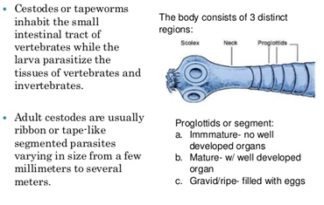
The Class Cestoda

Slide 7
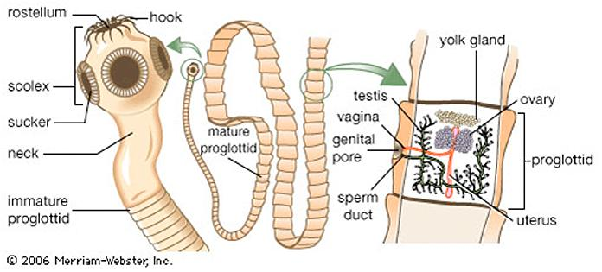

Slide 8
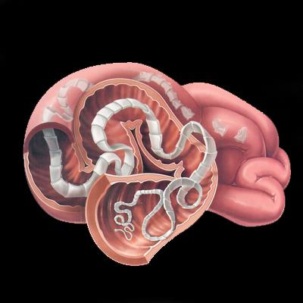

Slide 9
Cestodes of medical importance
Taenia solium
Taenia saginata
Diphyllobothrium latum
Echinococcus sp

Slide 10
TAENIA SOLIUM
Pock tapeworm

Slide 11
Transmission
By eating raw or undercooked beef for T. saginata
Raw or undercooked pork for T. solium
Human infection with T. solium larvae can occur by ingesting viable eggs from contaminated food or fingers

Slide 12
Disease
Stage of development
Disease
Larval form
Adult form
Cysticercosis
Taeniasis

Slide 13
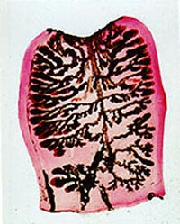
Gravid proglottid of T. solium
Notes:
Gravid proglottid, India ink technique.
Taenia solium
Note : Less than 14 lateral uterine branches (one side).
来源 http://www.medicine.cmu.ac.th/dept/parasite/official/cestode/frame_tr.htm

Slide 14
TAENIASIS
Adult tapeworm is located in human intestine.
Transmission is by eating raw or undercooked pork containing larva
In intestine larva takes 3 months to grow to adult tapeworm measuring 5m.
Symptoms : usually asymptomatic .
Adult form infection causes less damage than larval or egg stage infection
Sometimes mild symptoms may develop like Diarrhoea Weight loss

Slide 15
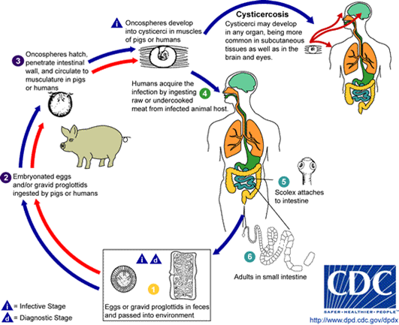

Slide 16
CYSTICERCOSIS
CYSTICERCOSIS Occurs By ingesting undercooked pork Eggs hatch in the small intestine onchospores are produced and burrow through wall into blood vessels Dessiminate to many organs especially the eyes and brain
Then encyst to form cysticerci Eventually cysticerci calcifies

Slide 17
CYSTICERCOSIS
Cysticerci may develop throughout the tissues of the body, but particularly the brain as there is an affinity for the brain NEUROCYSTICERCOSIS may result.
Its symptoms include Seizures:

Slide 18
CYSTICERCOSIS
Headache which indicates : Increased intracranial pressure meningitis
Cysticerci if develop in eyes causes uveitis result in decreased vision and blindness. Causes abnormal heart rhythm or heart failure if cysticerci develop in heart

Slide 19
CLINICAL FINDINGS
Patients with adult tapeworm are asymptomatic
Some notice proglottids in stools
Cysticercosis in brain causes seizures, headache,
In eyes :uveitis, retinitis or larva can be seen floating in vitreous

Slide 20
LABORATORY DIAGNOSIS
Gravid proglottid with 5-10 uterine branches can be observed in stool
Serologic test e.g ELISA
Eggs less often seen in stool CT scan

Slide 21
TREATMENT
Praziquantel, for intestinal worms.
Dose is 5–25 mg/kg by mouth single dose.
For cysticercosis praziquantel or albendazole.

Slide 22
Taenia Saginata
Beef tapeworm

Slide 23
T. saginata
T. saginata causes taeniasis
Does not cause cysticercosis
IMPORTANT PROPERTIES : Scolex with 4 suckers
No hooklets
Gravid proglottids have 15-25 uterine branches

Slide 24
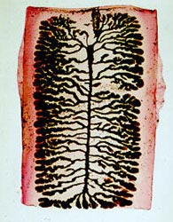
Gravid proglottid of T. saginata
Notes:
Taenia saginata
Gravid proglottid , India ink technique.
Note : More than 14 lateral uterine branches (one side).
来源 http://www.medicine.cmu.ac.th/dept/parasite/official/cestode/frame_tr.htm

Slide 25
Transmission
Humans are infected by eating undercooked beef containing larvae
Larvae grow into adult worm measuring 10m,
Gravid proglottids detach and are passed in feces
They are eaten by cattle
Embryo emerge from eggs in intestine , then carried to skeletal muscles develop into cysticerci

Slide 26
Hosts
Host description relative to parasite
Host
Human
Cattle
Definitive
Intermediate

Slide 27
CLINICAL FINDINGS
Adult form: asymptomatic
Malaise : mild cramps (pains)

Slide 28
LABORATORY DIAGNOSIS
Finding proglottids in stool
Eggs are found in stools less often than proglottids

Slide 29
TREATMENT
Praziquantel

Slide 30
Prevention
Cook beef properly
Dispose waste properly

Slide 31
Comparison of T. saginata and T. Solium
Characteristic | T. saginata | T. solium
Intermediate host | Cattle | Pig
Site of development | Muscle, viscera | Brain, skin, muscle
Scolex adult worm | No hooks | There are hooks
Cyaticercus | No rosterllum | Rostellum and hooks
Proglottids uterine branches | 23 (14-32) | 8 (7-11)
Passing of proglottids | Single | In groups
Ovary | Tow lobes | Three lobes

Slide 32
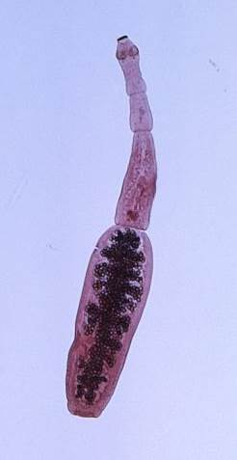
Echnococcus
Cestode parasites
  Family Taeniidae
Currently recognized species
    Echinococcus granulosus
    Echinococcus multiocularis
    Echinococcus vogeli
    Echinococcus oligarthrus
    Echinococcus shiguicus
Notes:
Echinococcosis is caused by several species of Echinococcus, tiny cestode parasites in the family Taeniidae. Currently recognized species include Echinococcus granulosus, E. multilocularis, E. vogeli, E. oligarthrus and E. shiquicus.
[Photo: Photomicrograph revealing internal morphology of an adult cestode, Echinococcus granulosus, found in a dog. Source: CDC Public Health Image Library]

Slide 33
Echinococcus granulosus
Echinococcus granulosus causes a type of echinococcosis known as
  Cystic echinococcosis
  Unilocular echinococcosis
  Cystic hydatid disease
This species has traditionally been divided into strains, named G1 to G10,
Some strains have been proposed as species. E. granulosus sensu lato (E. granulosus s. l.) can be used as a general term for all of the species and strains.
Notes:
E. granulosus causes a type of echinococcosis known as cystic echinococcosis, unilocular echinococcosis or cystic hydatid disease. This species has traditionally been divided into strains, named G1 to G10, which have a degree of host adaptation and are maintained in distinct cycles. Some strains have been proposed as species. E. granulosus sensu lato (E. granulosus s. l.) can be used as a general term for all of the species and strains.

Slide 34
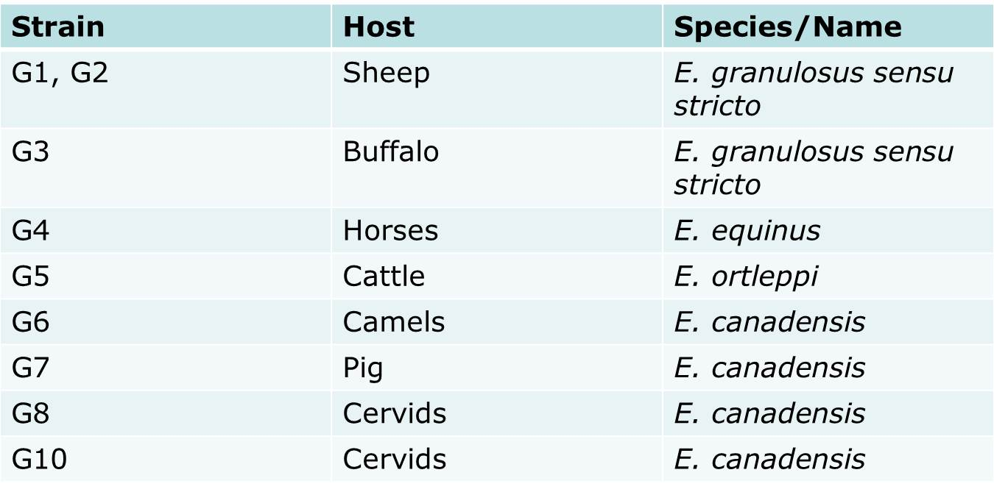
E. granulosus Strains
Some strains have been proposed as species. E. granulosus sensu lato (E. granulosus s. l.) can be used as a general term for all of the species and strains.
Notes:
Two strains - the G1 sheep strain and the G2 Tasmanian sheep strain, primarily use sheep as their intermediate host, but can also infect a variety of other species. Together with the G3 buffalo strain, the G1 and G2 strains are called Echinococcus granulosus sensu stricto. The G4 strain, which occurs only in equid intermediate hosts, does not mature in media that support the growth of the sheep strains, and does not seem to be zoonotic, is called E. equinus. G5 cattle strain has been designated Echinococcus ortleppi. It is unusual in that it regularly uses cattle, which are rarely affected by other strains, as intermediate hosts. The G6 camel strain, G7 pig strain, a poorly characterized G9 strain, and two cervid strains, G8 and G10, might comprise another species called E. canadensis. The G9 strain has been reported only from human cases in Poland, and some authors consider it to be a variant of the G7 pig strain. A lion strain has been reported from Africa. Unlike most Echinococcus species, which have canids as their primary definitive hosts, this strain mainly uses felids. It has also been called E. felidis. Some strains are still poorly characterized, and additional strains probably exist.

Slide 35
E. multilocularis
E. multilocularis causes a type of echinococcosis known as:
  Alveolar echinococcosis
  Alveolar hydatid disease
  Multilocular echinococcosis
  Multivesicular hydatidosis
Multiple strains
  Less distinct than E. granulosa s.l.
Notes:
E. multilocularis causes a type of echinococcosis known as alveolar echinococcosis, alveolar hydatid disease, multilocular echinococcosis or multivesicular hydatidosis. It has been divided into Eurasian, North American and Chinese ‘strains,’ which are less distinct than those of E. granulosus s.l. One group of organisms has been proposed as a distinct species, Echinococcus shiquicus. E. shiquicus has been isolated only from small mammals and Tibetan foxes (Vulpes ferrilata) from the Tibetan Plateau region of China. Whether it should receive its own species designation is still uncertain.

Slide 36
Echinococcus vogeli and Echinococcus oligarthrus
Infections with Echinococcus vogeli and Echinococcus oligarthrus are usually known as polycystic echinococcosis (or neotropical polycystic echinococcosis), from the form of the disease in intermediate hosts.
Because E. oligarthrus has been reported only as one or more discrete cysts in humans, this disease has also been called unicystic echinococcosis.
Notes:
Infections with Echinococcus vogeli and Echinococcus oligarthrus are usually known as polycystic echinococcosis (or neotropical polycystic echinococcosis), from the form of the disease in intermediate hosts. Because E. oligarthrus has been reported only as one or more discrete cysts in humans, this disease has also been called unicystic echinococcosis.

Slide 37
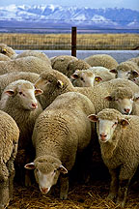
Zoonotic Species
G1 (sheep strain)
E. granulosus s.l. Most frequent cause of disease in humans
Other species may be important regionally
Notes:
The G1 sheep strain of E. granulosus s. l., which is particularly widespread, is the most frequent cause of disease in humans. Regionally, other E. granulosus s. l. strains/ species may be more important than G1. Some strains or species of Echinococcus affect people infrequently, or grow relatively slowly and are less likely to cause disease. E. oligarthrus seems to be extremely rare in people, and E. equinus (E. granulosus strain G4) has not been reported to be zoonotic in the literature.
[Photo: Flock of sheep. Source: USDA ARS]

Slide 38
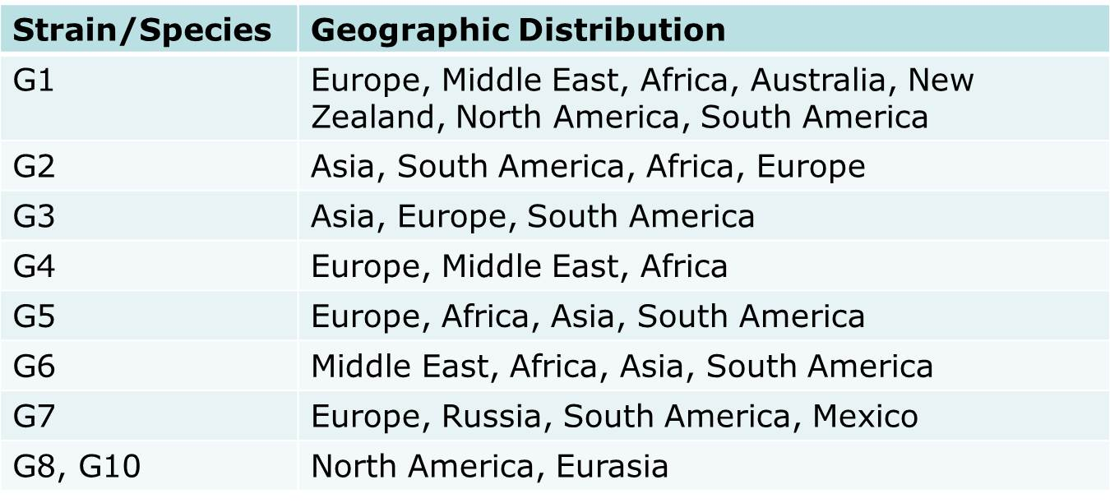
Distribution
E. granulosus s.l.
E. multilocularis
  Northern hemisphere
    Eurasia, Europe, North America
E. vogeli, E. oligarthrus
  Central and South America
E. shiquicus
  China
Notes:
E. granulosus s. l. occurs worldwide, with the exception of a few countries such as Iceland and Greenland. Within an area, its distribution may be focal. Each strain/species has a distinct geographic range. The G1 sheep strain is cosmopolitan; it has been reported in Europe, the Middle East, Africa, parts of Asia, Australian, New Zealand, and North and South America. In North America, this strain has mainly been reported from the western U.S. It also occurs in Mexico. The G2 Tasmanian sheep strain was once thought to be limited in its geographic range, but it has now been identified in Asia, South America, Africa and Europe, as well as in Tasmania. The G3 strain has been reported from Asia, Europe and South America, and the G4 strain (E. equinus) is known to occur in Europe, the Middle East and Africa. The G5 cattle strain (E. ortleppi) has been documented in Europe, Africa, parts of Asia, and South America, and the G6 camel strain is known to occur in the Middle East, Africa, Asia and South America. The G7 pig strain has been identified in Europe, Russia, South America and Mexico, while the closely related G9 strain has been reported only from Poland. The G8 and G10 cervid strains have been found in North America, mainly in Canada and some northern U.S. states, as well as in Eurasia. E. felidis (the “lion strain”) is thought to occur only in Africa. Molecular techniques have recognized many strains/species in new areas during the last 5-10 years, and these geographic ranges are probably incomplete.

Slide 39
Transmission
Indirect life cycle
In many cases, the parasite cycles through specific predators or scavengers, and their prey.
Definitive hosts become infected when they ingest cysts (metacestodes) in the tissues of the intermediate hosts.
The cysts develop into tapeworms, which mature in the host’s small intestine.
Gravid proglottids or eggs are shed in the feces, and are immediately infective. Under ideal conditions, eggs remain viable for several weeks or months in pastures or gardens, and on fomites. They survive best under moist conditions and in moderate temperatures.
The intermediate hosts include a large number of domesticated and wild animals, particularly herbivores. Humans can also be infected. If an intermediate host ingests the eggs, the larvae are released, penetrate the intestinal wall, and are carried in blood or lymph to the target organs.
Notes:
Echinococcus species have an indirect life cycle, and must develop in both an intermediate and a definitive host. In many cases, the parasite cycles through specific predators or scavengers, and their prey. Definitive hosts become infected when they ingest cysts (metacestodes) in the tissues of the intermediate hosts. The cysts develop into tapeworms, which mature in the host’s small intestine. Gravid proglottids or eggs are shed in the feces, and are immediately infective. Under ideal conditions, eggs remain viable for several weeks or months in pastures or gardens, and on fomites. They survive best under moist conditions and in moderate temperatures. The intermediate hosts include a large number of domesticated and wild animals, particularly herbivores. Humans can also be infected. If an intermediate host ingests the eggs, the larvae are released, penetrate the intestinal wall, and are carried in blood or lymph to the target organs.

Slide 40
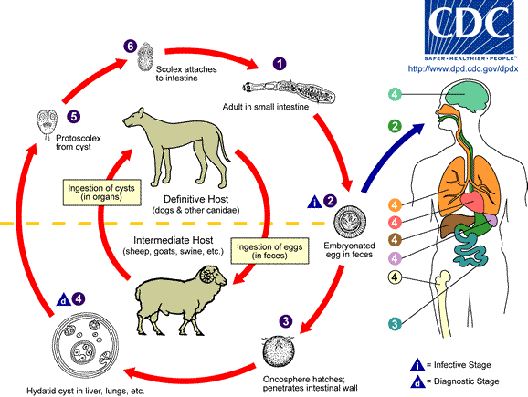
Notes:
Human echinococcosis is caused by the larval stages of cestodes (tapeworms) of the genus Echinococcus. The adult Echinococcus granulosus (3 to 6 mm long) resides in the small bowel of the definitive hosts, dogs or other canids. Gravid proglottids release eggs that are passed in the feces. After ingestion by a suitable intermediate host (under natural conditions: sheep, goat, swine, cattle, horses, camel), the egg hatches in the small bowel and releases an oncosphere that penetrates the intestinal wall and migrates through the circulatory system into various organs, especially the liver and lungs. In these organs, the oncosphere develops into a cyst that enlarges gradually, producing protoscolices and daughter cysts that fill the cyst interior. The definitive host becomes infected by ingesting the cyst-containing organs of the infected intermediate host. After ingestion, the protoscolices evaginate, attach to the intestinal mucosa , and develop into adult stages in 32 to 80 days.
Image: Life cycle of Echinococcus. Source: CDC Division of Parasitic Diseases]

Slide 41
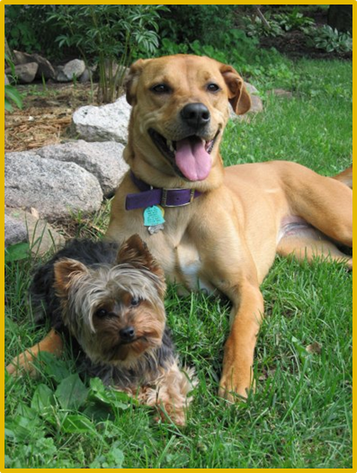
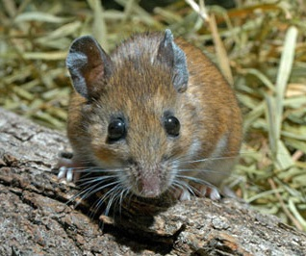
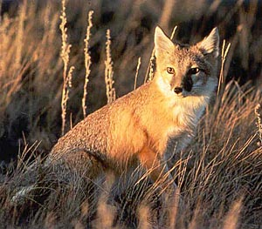
Transmission
E. multilocularis
Definitive hosts
  Wild carnivores (e.g., fox)
  Domestic dogs and cats
Intermediate hosts
  Small mammals (rodents)
  Domesticated mammals
  Humans
E. granulosus s.l.
Definitive hosts
  Canids
  Felids
  Hyaenids
Intermediate hosts
  Herbivores
  Humans
Notes:
The definitive hosts for E. granulosus s. l. are canids, felids, and hyaenids. Echinococcus eggs have a sticky coat that will adhere to an animal’s fur and other objects. Insects such as flies and beetles, or birds, can also act as mechanical vectors. In addition, the shed proglottids may perform rhythmic contractions that help to disperse the eggs widely on pastures.
[Photo: Dogs. Source: Nichollette Rider/CFSPH]

Slide 42
Transmission
E. vogeli
  Definitive hosts
    Bush dogs
    Domestic dogs
  Intermediate hosts
    South American rodents (e.g., pacas)
E. oligarthrus
  Definitive hosts
    Wild felids
  Intermediate hosts
    Rodents
Notes:
The definitive hosts for E. vogeli are bush dogs (Speothos venaticus) and the intermediate hosts are South American rodents, especially pacas (Cuniculus paca). Dogs, which may be given the entrails from pacas after a hunt, can also act as definitive hosts. The definitive hosts for E. oligarthrus are wild felids, and the intermediate hosts are rodents.

Slide 43
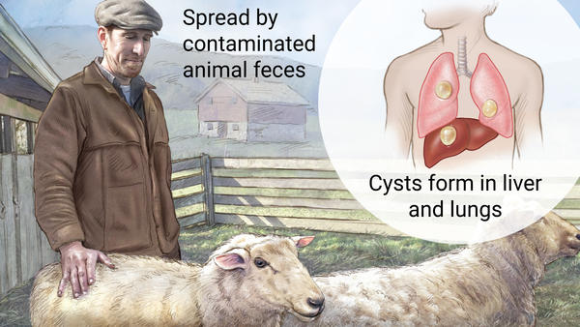
Zoonotic Transmission
Humans act as intermediate hosts
Ingest tapeworm eggs shed by definitive hosts
  Contaminated fruits, vegetables, herbs, water
Notes:
Humans act as intermediate hosts for Echinococcus spp., and are infected when they ingest tapeworm eggs from the definitive host. The eggs may be eaten in foods such as vegetables, fruits or herbs, or drunk in contaminated water. They can also stick to the hands when a person pets an infected dog or cat, handles a wild animal or its carcass, or touches contaminated soil and vegetation. Uninfected pets may carry the eggs on their fur if they contact the feces of infected wild hosts. This is probably more common in dogs, which may roll in feces.

Slide 44
Disease in Humans
Incubation period
  Month to years
  20 to 30 years documented for cysts that grow slowly and are not in a critical location
Clinical signs
  Depend on size, number and location of metacestodes
Notes:
The incubation period for echinococcosis varies from months to years. It can be as long as 20-30 years, if the cyst grows slowly and is not in a critical location. The symptoms of echinococcosis depend on the size, number and the location of the metacestodes. Until the cysts become large enough to damage adjacent tissues and organs, they are usually asymptomatic. The clinical signs are those of a mass lesion.

Slide 45
Disease in Humans
E. granulosus s.l.
May be asymptomatic
Usually one cyst present
Cyst location
  60 to 70% in liver
  20 to 25% in lungs
Symptoms dependent on cyst location
E. multilocularis
Cysts usually found in liver
Cysts not enclosed within membrane
  Invade surrounding tissues
  Disease is progressive and malignant
May be asymptomatic if cyst dies early in development
Notes:
E. granulosus s. l. cysts can remain asymptomatic for many years. They are usually well tolerated until they cause pressure on surrounding tissues. The symptoms resemble those of a slowly growing tumor. Although most people have only one cyst, multiple cysts can be found. Approximately 60-70% of E. granulosus s. l. cysts occur in the liver and 20-25% in the lungs. The remaining cysts can be found almost anywhere in the body including the bones, kidneys, spleen, muscles, CNS and behind the eye. Depending on the location, some cysts can become very large and may contain up to several liters of fluid. Others in critical locations such as the brain become symptomatic when they are still small. Secondary cystic echinococcosis occurs when a cyst leaks or ruptures; dissemination is seen mainly in the abdominal cavity. Leakage of the cyst fluid can also cause allergic reactions including shaking chills and/or fever, asthma, pruritus, urticaria or life-threatening anaphylaxis Other symptoms vary with the location(s) of the cysts. E. granulosus s. l. cysts can also be asymptomatic throughout the individual’s life, and may be incidental findings at surgery or autopsy. Some cysts may die and not develop further.

Slide 46
Disease in Humans: E. vogeli, E. oligarthrus
Cysts usually originate in liver
  Can spread to nearby organs/tissues
Symptoms dependent on cyst location
Notes:
E. vogeli tends to occur initially in the liver; however, the cysts are invasive and can spread to nearby organs and tissues. The clinical signs resemble alveolar echinococcosis. Common symptoms with liver involvement include hepatomegaly, abdominal distension, weight loss, abdominal pain, jaundice and anemia. Palpable masses, which may or may not be painful, can be present in the liver or abdomen, and there may be signs of portal hypertension or biliary obstruction. Coughing, chest pain and hemoptysis can be seen if the lung in involved, and the rupture of esophageal varices can result.

Slide 47
Diagnosis
Imaging techniques
  Ultrasound, radiology, MRI, CT
Serology
Biopsy
Detection of protoscolices
  Cyst fluid, sputum
PCR
Treatment
Surgical removal of cysts
  May not be possible to remove entire cyst depending on size and location
Anti-parasitics: Albendazole
Liver transplant
Notes:
In humans, echinococcosis is diagnosed mainly with imaging techniques such as ultrasonography, radiology, magnetic resonance imaging (MRI) or CT scanning, supported by serology. Serological tests used in humans include enzyme-linked immunosorbent assays (ELISAs), indirect immunofluorescence, indirect hemagglutination, immunoblotting and latex agglutination. Some people with cysts do not develop detectable antibodies. False positives, which include cross-reactions with other taeniid cestodes, are also possible. Biopsies can also be used in diagnosis, but there is risk of cyst leakage or rupture, and antiparasitic drugs must be given concurrently. Ultrasonography-guided fine-needle puncture can distinguish cysts from tumors, abscesses and other lesions. The cyst fluid recovered with this technique can be examined for protoscolices and other evidence of the parasites. It may also be tested for Echinococcus antigens with an antigen-detection ELISA, or for parasite DNA using polymerase chain reaction (PCR) assays. When the lungs are affected, protoscolices might be found in sputum or bronchial washings. Echinococcus species can be distinguished by PCR followed by sequencing or restriction fragment length polymorphism analysis. Both nuclear and mitochondrial genes are used in differentiating species/ strains. Cysts from different species can also be distinguished by the morphology of the protoscolices, if they are present. In humans, some cysts are “sterile”; they do not produce protoscolices.
[Photo: Under a low magnification of only 100X, this photomicrograph revealed three Echinococcus sp. protoscolices, which had been liberated from a hydatid cyst. Rupture of these cysts releases these larval protoscolices, and a condition known as “hydatid sand”. Source: CDC Public Health Image Library]

Slide 48
Prevention in Humans
Control echinococcosis in domestic animals
  Don’t feed livestock entrails to dogs
  Don’t allow dogs and cats to hunt
  Regularly test and/or treat animals allowed outside
Minimize risk of egg ingestion
  Wash fruits and vegetables
  Wash hands frequently
  Avoid untreated water sources
  Do not handle wild carnivores or their carcasses
  Thoroughly cook meat before eating
Wear personal protective equipment
Regular surveillance
  Laboratory personnel
  Children exposed to feces of infected animals
No vaccine
Notes:
Controlling Echinococcus spp. that occur in domesticated animal cycles reduces human exposure. In particular, dogs should not be fed the entrails from livestock at slaughter. Because dogs and cats can also be infected from parasites in wildlife cycles, they should not be allowed to hunt wild animals, or be fed any tissues from these species. In endemic areas, regular testing and/or treatment is advisable in animals allowed outside.

Slide 49
Prevention in Animals
Regular surveillance
Treat infected animals (dogs)
  Praziquantel
  Multiple doses required
Vaccination
  Recombinant
Notes:
Dogs may be treated with anthelminthic agents before they are allowed to enter Echinococcus-free areas. Praziquantel is often used. One-time treatment is not adequate; definitive hosts often become reinfected if they are re-exposed. Dogs that might be infected should not be allowed onto pastures where livestock may graze. In some countries, foxes have been treated with praziquantel in bait to decrease the incidence of E. multilocularis, and the risk to other species. Eradication or control programs for the E. granulosus sheep/dog cycle have been successful in some areas, particularly on islands such as Iceland, New Zealand and Tasmania. These programs have targeted the parasite in domesticated dogs by regular surveillance, and if necessary, treatment. Education campaigns have also been used, either alone or in conjunction with programs aimed at dogs. The elimination of farm slaughter of sheep reduces the risk that dogs will be infected from this source. A recombinant vaccine for E. granulosus in sheep has been successful in field trials. This vaccine has been licensed to a commercial group in the People’s Republic of China. Models suggest that livestock vaccines would be most effective if combined with testing and treatment of dogs.

Slide 50
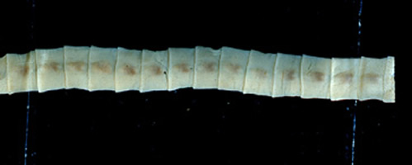
Diphyllobothrium latum The fish Tapeworm
Causes diphyllobothriasis disease
The adult worm is a member of the order Pseudophyllidea.
Prevalence worldwide, where freshwater or brackish water fish are consumed raw.
Diphyllobothrium latum is the largest parasite of humans reaching lengths up to 10 m or more and consisting of a chain of 3,000 to 4,000 proglottids, each up to 2 cm wide.

Slide 51
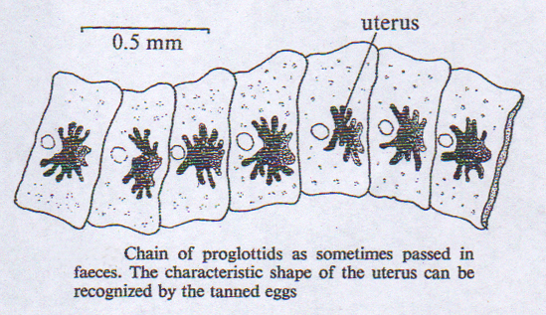
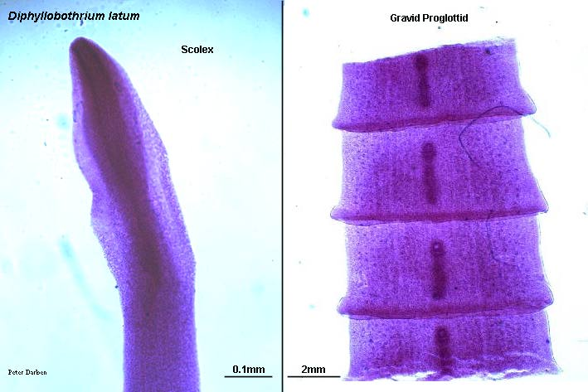
Scolex elliptical or spatula-like or almond in shape, long 2 – 3 mm and provided with a pair of linear sucking grooves (bothria).
It has a rosette-shaped uterus connected to the outside by a uterine pore through which the eggs are passed. Hence, mature segments produce eggs until they die and are shed, rather than by breaking off as intact egg-filled segments, as in Taenia.
Up to a million eggs can be produced daily.

Slide 52
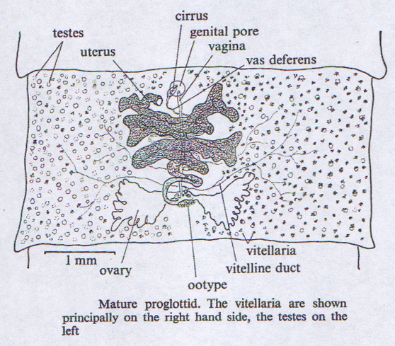
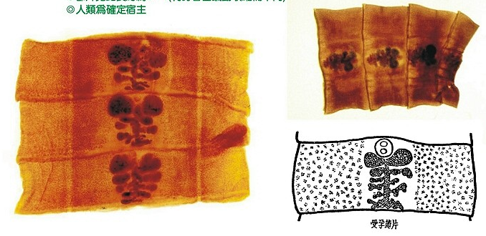
The pore open on the ventral surface
Rosette from uterus or( coiled uterus )
Diphyllobothrium latum matuer or gravid Segments

Slide 53
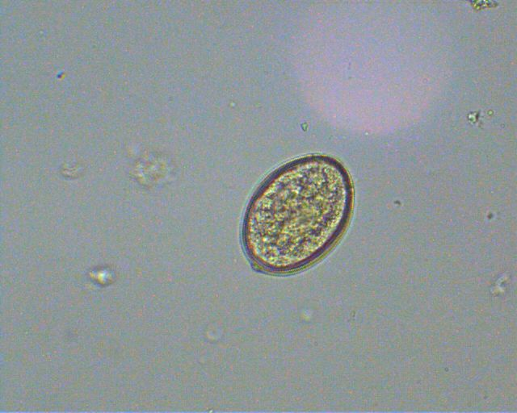
Eggs are 30 x 50 µm in size, ovoid, light golden-yellow and have an operculum at one end with a small thickening of the shell at the opposite end.
They contain an embryo with 3 pairs of hooklets.
Fully developed eggs are discharged through the uterine pore, terminal proglottid gradually become exhausted and disintegrate.
Egg/ova with operculum at one end and a small knob at the other end.
A single egg gives rise to a single larva.
Not infective to man

Slide 54
Life cycle
Man and other animals are infected by eating uncooked fish that contains plerocercoid larvae (15 x 2 mm) )sparganum) which attach to the small intestinal wall and mature into adult worms in 3 to 5 weeks.
Eggs discharged from gravid proglottids in the small intestine are passed in the feces.
The egg hatches in fresh water to produce a ciliated oncosphere (coracidium) which needs to be ingested by a water flea (Cyclops) where it develops into a procercoid larva.
When infected Cyclops are ingested by the freshwater fish (plankton feeding fish), the procercoid larva penetrates the intestinal wall and develops into a plerocercoid larva (sparganum), infectious to man, cat, dog, or bear.
After ingestion of the infected fish, the plerocercoid develop into immature adults and then into mature adult tapeworms which will reside in the small intestine.
The adults of D. latum attach to the intestinal mucosa by means of the two bilateral grooves (bothria) of their scolex.
Immature eggs are discharged from the proglottids (up to 1,000,000 eggs\ day\ worm) and are passed in the feces.
Eggs appear in the feces 5 - 6 weeks after infection. In addition to humans, many other mammals can also serve as definitive hosts for D. latum.

Slide 55
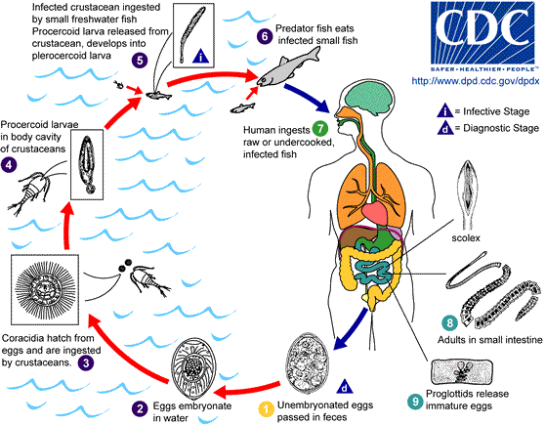
Life cycle:

Slide 56
Note:
Eggs must be discharged into cool fresh water where they emberyonated and hatch.
The emerging ciliated embryo must be eaten by a copepod in which the embryo transforms into a procercoid.
The infected copepod (Cyclops) must then be eaten by a plankton-feeding fish in the flesh of which the procercoid transforms into a plerocercoid (sparganum).
The infected fish must be eaten raw by the definitive host in whose intestine the larva develops into the adult worm.
Although dogs and bears are reservoirs of D. latum, man is primarly responsible for maintaining the life cycle of D. latum.

Slide 57
Pathogenesis & Symptoms
Infection with Diphyllobothrium latum is usually asymptomatic, although occasional diarrhea, abdominal pain, fatigue, vomiting, dizziness, loss of appetite, anorexia and nausea.
Bothriocephalus anemia (anemia and neurological problems associated with vitamin B12 deficiency are seen in heavily infected individuals.(
The infection accompanied by peptic ulcer and appendicitis.
The infection may be multiple.

Slide 58
Diagnosis:
Stool examination
Diagnostic stage:
Egg with operculum
A single worm may produce up to 15000 eggs/ gm. of feces.
Treatment:
Praziquantel is the drug of choice.
Niclosamide.
Control
Freezing for 24 hours, thorough cooking or pickling of fish kills the larvae.
Fish reservoirs should be kept free of raw sewage.

Slide 59
Thank you

